Slide 1
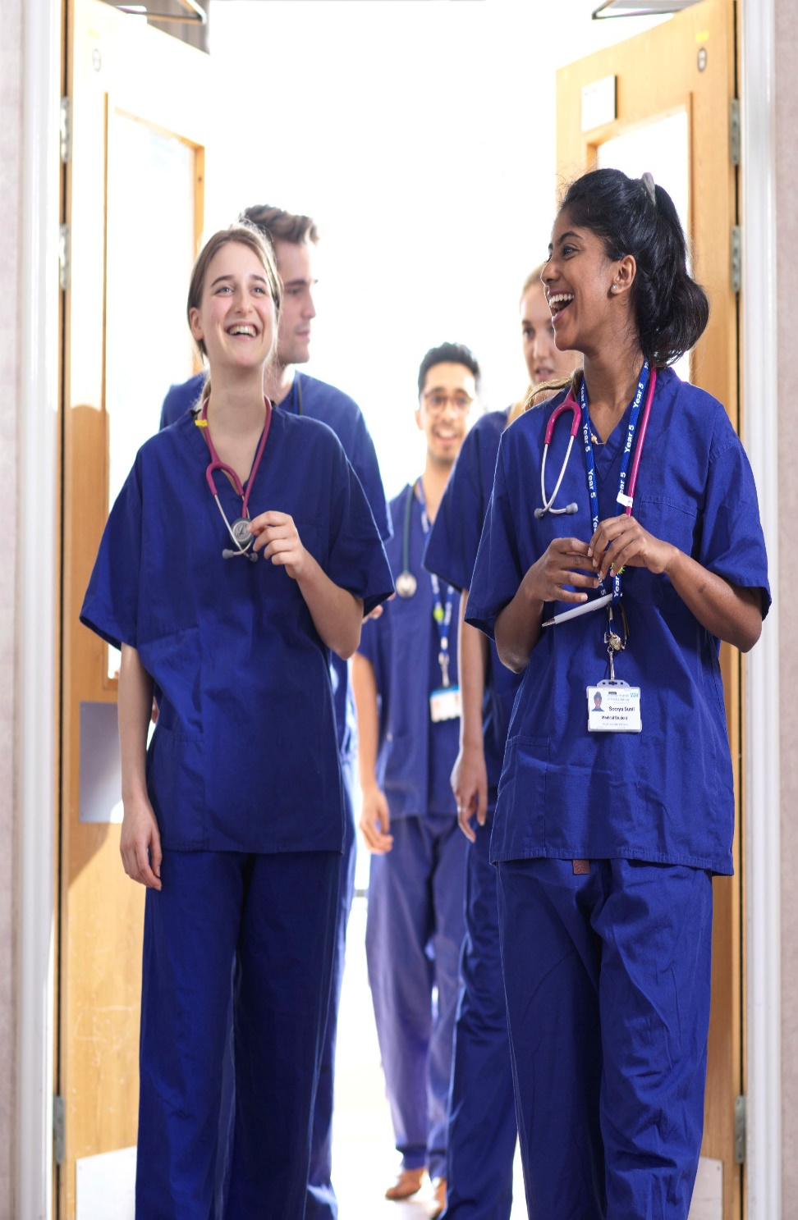

Studying Medicine
Dr Nicola Phillips
Teaching Fellow & Admissions Tutor

Slide 2

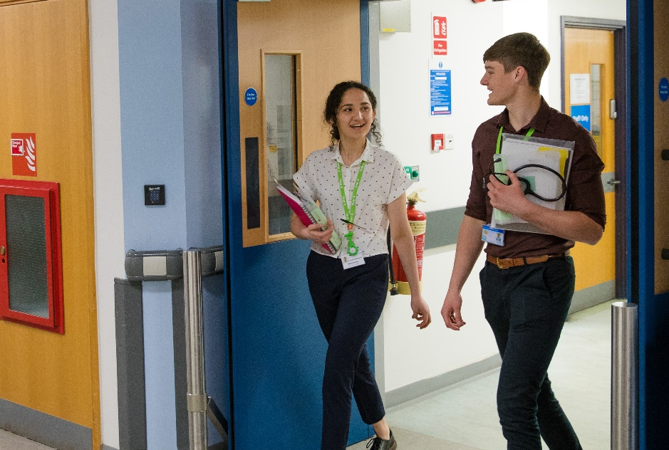
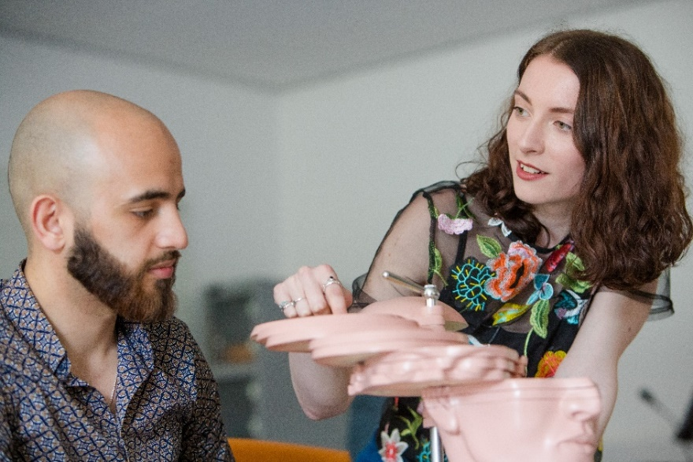
What do medical students learn?
It’s not like other degree courses…
Notes:
Longer duration
Professional training
Experiential learning
Mastery of a breadth of subjects
Skills (clinical and communication) and knowledge

Slide 3
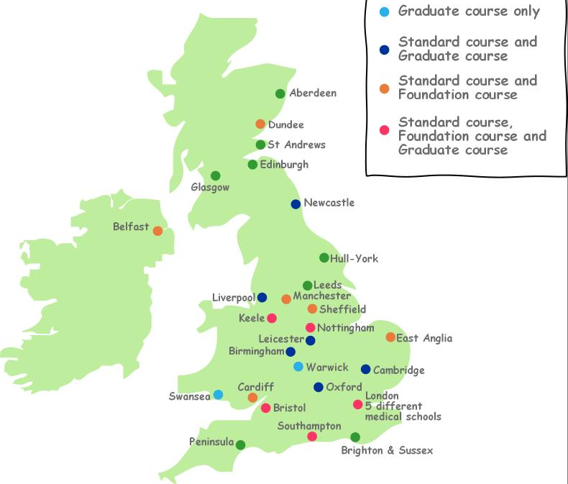
UK Medical schools
Example image
Increase in medical student numbers in England:
~6000 in 2017
~6500 in 2018
~7500 from 2019 onwards
New medical schools
UCLan
Aston
Anglia Ruskin
Canterbury
Edgehill
Lincoln
Sunderland
Standard course only
Graduate course only
Standard and
Graduate courses
Standard and Foundation courses
Sunderland
Standard, Foundation
& Graduate courses
New medical schools
Lancaster
UCLan
Edgehill
Lincoln
Aston
Anglia Ruskin
Canterbury
Exeter
Plymouth

Slide 4
How is the teaching delivered?
Traditional:
Based at University for years 1+2 (+3)
Mostly lectures; subject-based
Clinical placement for years 3-5 (+6)
Problem-based learning:
Self-directed learning in small groups
Split into systems (learn “holistically”)
Earlier clinical exposure
Integrated curricula:
Mixture of lectures and small group teaching
Earlier clinical experience

Slide 5

Choosing a medical school
Personal recommendation
Reputation or status of medical school
Entry requirements
  Subject requirements
  Grade requirements
  UCAT? BMAT?
Choose universities which suit your needs –location; living and travel costs; extra-curricular activities etc

Slide 6
Studying Medicine at Lancaster
Medicine & Surgery, MBChB, 5 year
Problem-based learning
Early clinical experience
Small student numbers
  125 UK/EU students per year
  Plus overseas places

Slide 7
What do our medical students learn?
PBL
Biomedical
Sciences
Public Health
Sociology
Of Health
Good Patient Care
Health
Psychology
Ethics &
Professionalism
Clinical
Skills
Communication
Skills

Slide 8
PBL: discussion of the scenario helps students set their learning objectives

Slide 9
Problem-based learning
Set own
Learning
Objectives
Read &
Discuss
Scenario
Reinforce learning
through discussion
Self
Study

Slide 10
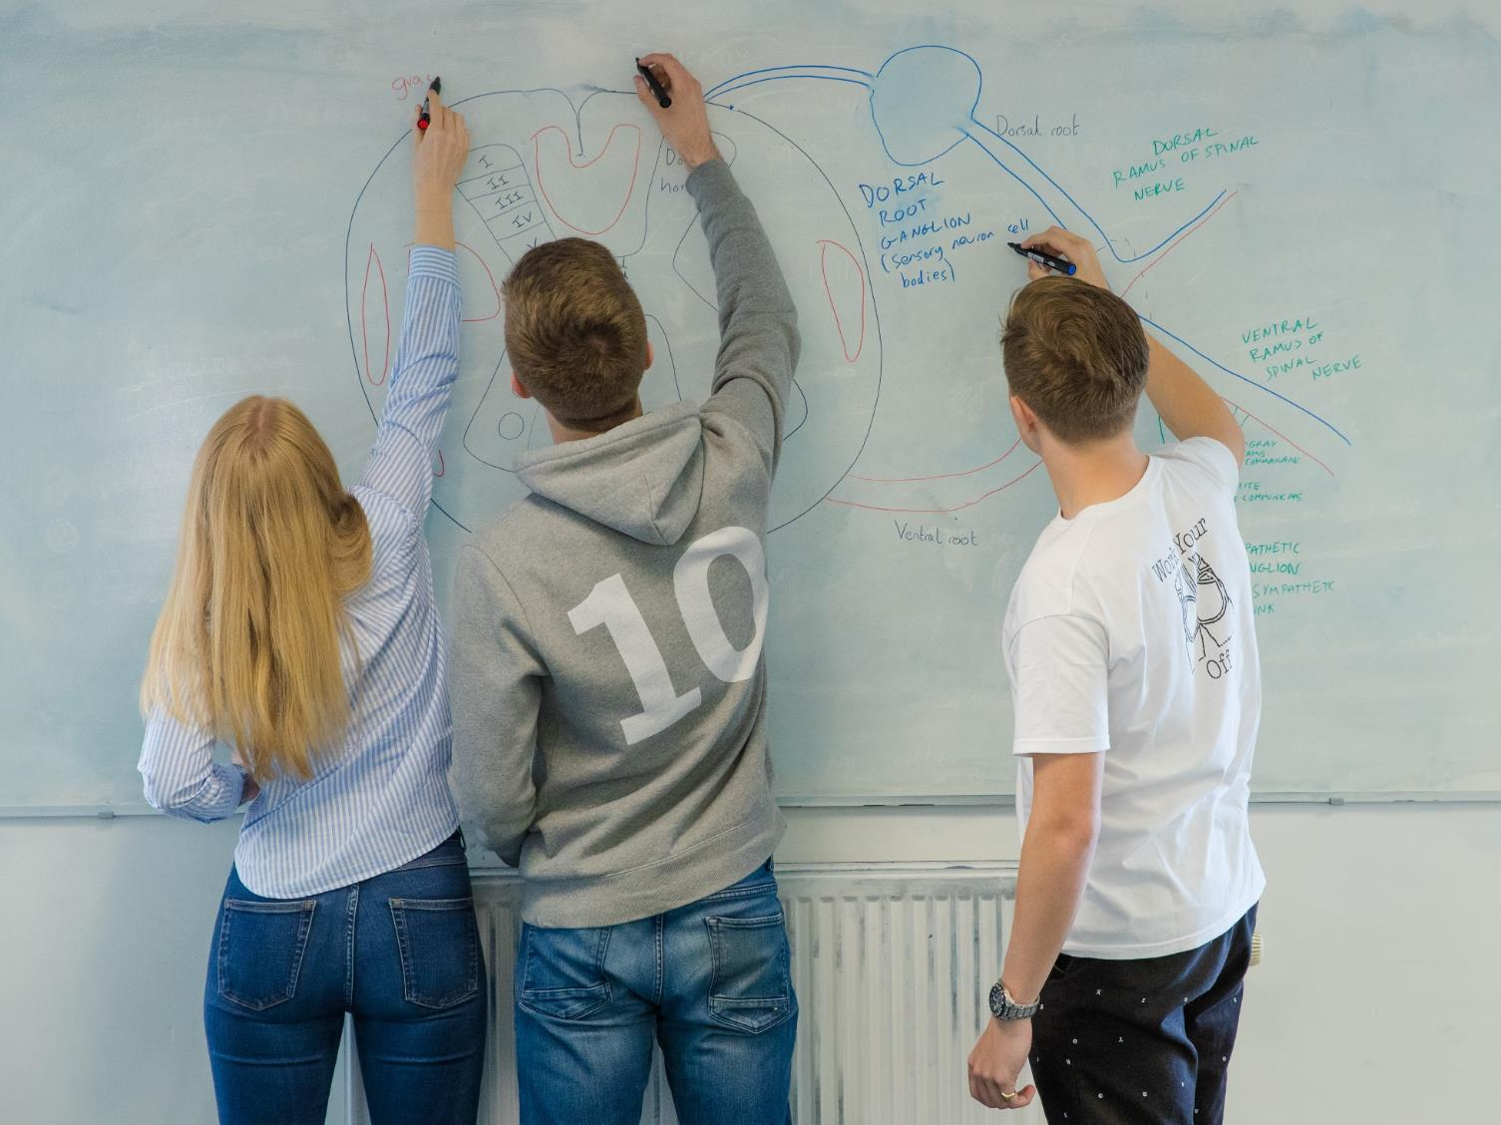
Check what you’ve learnt
Teach other group members
Allows tutor to probe knowledge

Slide 11
PBL develops good
problem solving
teamwork
communication
study skills
Set own
Learning
Objectives
Scenario
Read &
Discuss
Reinforce learning
through discussion
Self
Study
Makes the student a life-long learner.

Slide 12

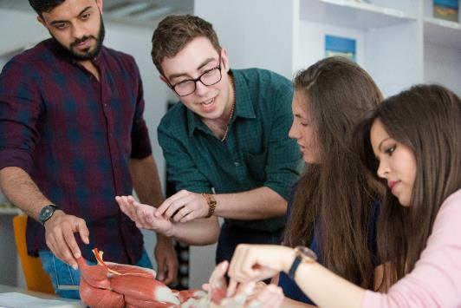
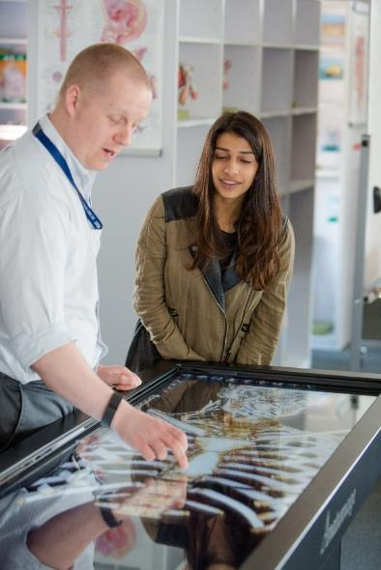
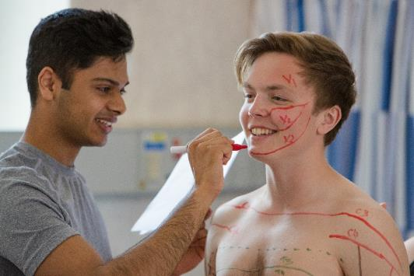
Anatomy teaching
No dissection
Clinically focused
Experiential learning
Digital technology
Post-mortem sessions
https://vimeo.com/345004661/2080f36f91

Slide 13
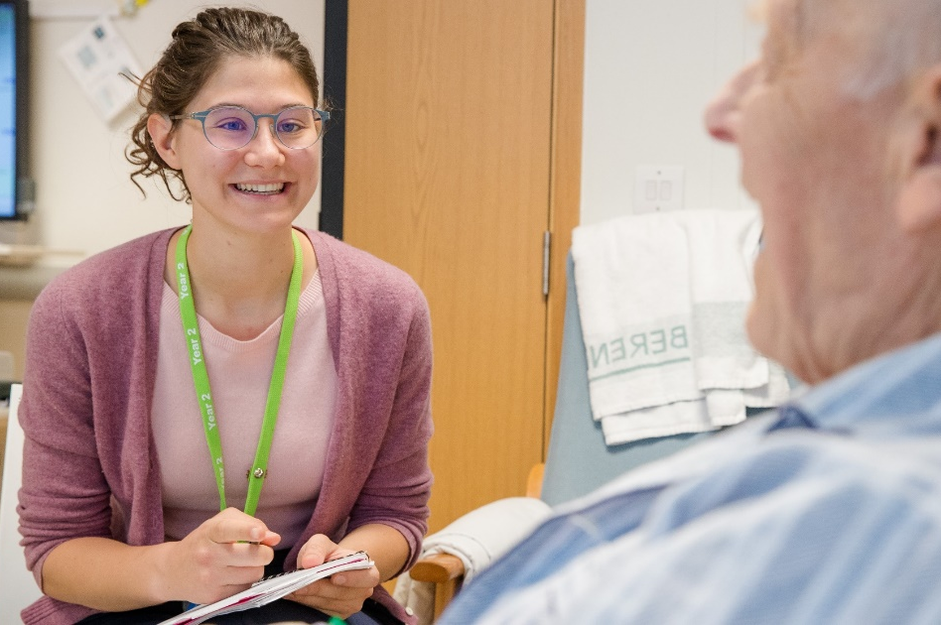
Communication Skills training
Practice communicating with peers
Discussion
Role play
Simulated patients
Constructive feedback
  including use of videoing

Slide 14
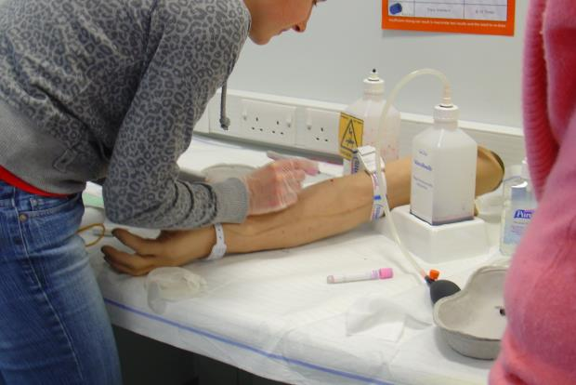
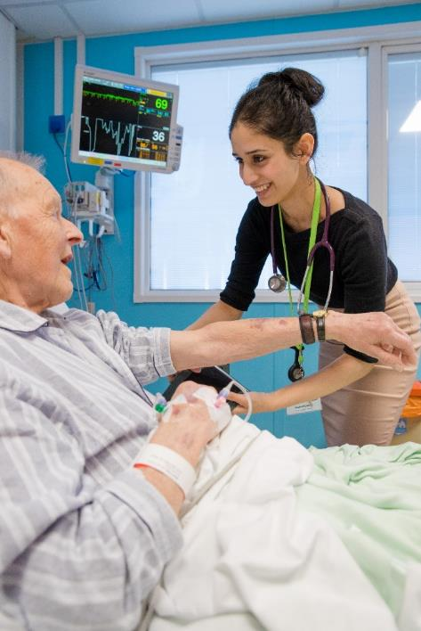
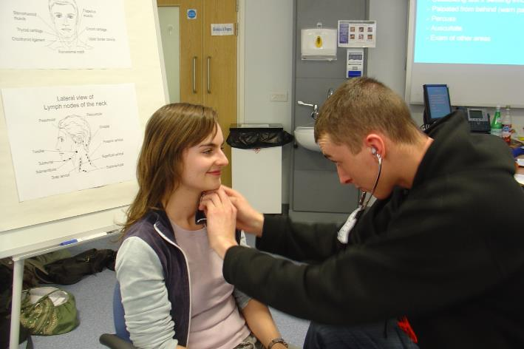
Clinical Skills

Slide 15
Early clinical experience
Community placement in Year 1
Year 2: two days per week in hospital; plus GP placement, health promotion and community project
Year 3 onwards: based entirely in clinical placement

Slide 16
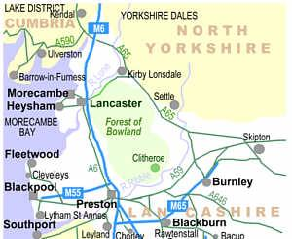
Clinical Placements
Westmorland
Hospital
Furness General
Hospital
X
Community Placements in Lancashire & South Cumbria
Royal Lancaster
Infirmary
Royal Blackburn
Hospital
Blackpool
Victoria hospital

Slide 17

2021 entry

Slide 18
What are we looking for?
Well-rounded individuals
Thoughtful, caring and compassionate
Insightful
Values
Motivated and conscientious
Academically able
Resilient

Slide 19
LMS Selection Process
Academic Excellence
    achieved and predicted grades
Medical Admissions Test
    BMAT
Interview
    Personal Statement
Fitness to Practice
Academic criteria
Non-academic criteria

Slide 20
Academic entry criteria
Academic excellence:
GCSE: in eight subjects, 6-9s, including
  Science (Core & Additional or Biology, Chemistry and Physics),
  English Language and
  Maths
A-LEVELS: AAA-AAB
  Must include two of Biology, Chemistry or Psychology
  Third A-level can be any academic subject
  AAB 3 A Levels + EPQ @ B

Slide 21
Widening Participation
Meet our WP criteria?
Predicted AAB or above
Predicted BBB - ABB
A100
A104
Standard offer
AAB - AAA
WP offer
ABB
Standard offer
ABB
May be confirmed on lower grades

Slide 22
A100:
Contextually lowered offers
For certain applicants who fulfil widening participation criteria
  Dual offer: AAA or
  ABB if they make Lancaster Medical School their FIRM choice and attend a post-offer event.
Example of widening participation criteria:
  Low income household
  School context: non-selective state; Attainment 8 score
  First in family to attend university
  Refugee, local authority care leaver, young carer
http://www.lancaster.ac.uk/lms/study-with-us/undergraduate/mbchb/entry-requirements-and-selection-process/contextual-offer-scheme/

Slide 23
A104: Medicine with a Gateway Year
Designed for students who are not eligible to apply directly for the Medicine & Surgery programme.
For applicants who fulfil widening participation criteria
  Low income household
  School context: non-selective state; Attainment 8 score
  First in family to attend university
  Refugee, local authority care leaver, young carer
Standard offer: ABB
http://www.lancaster.ac.uk/lms/study-with-us/undergraduate/foundation-year/

Slide 24

BioMedical Admissions Test (BMAT)
Independent measure of academic ability
Take it at two points in the year
  BMAT August / BMAT October
Bursary for students from low income households
Three sections test different skills

Slide 25
BMAT
Section 1 – Thinking Skills
problem solving, critical thinking.
Section 2 - Scientific Knowledge and Applications
application of scientific knowledge (Key stage 4 Science and Maths)
Section 3 - Writing Task
- ability to select, develop and organise ideas, and communicate them in writing in a concise and effective way
Ranking according to BMAT score will determine who gets to interview

Slide 26
BMAT *Check for COVID19 updates*
Key dates (for 2021 entry):
BMAT September*
  Register: 22nd June – 9th August 2020
  BMAT Sept: 5th September 2020 (~20 test centres in UK)
  BMAT results: 25th September 2020 – to test takers only
BMAT November
  Register: 1st September - 1st October 2020
  Late registration: before 15th October 2020
  BMAT test: 4th November 2020 (in school, college or test centre)
  BMAT results: 27th November 2020

Slide 27
Preparing for BMAT
Myth One: You need to be studying A-level Maths & Physics
No, the knowledge assessed in Section 2 is based on GCSE Science & Maths but the style of question is different
Myth Two: BMAT is super-difficult
If you are good at science, you will probably be good at BMAT
Myth Three: You need to pay for an expensive preparation course to be able to get a good BMAT score
No, there is no evidence that attending a course improves applicants’ scores. All you need to help you prepare can be found, FOR FREE, on the BMAT website

Slide 28
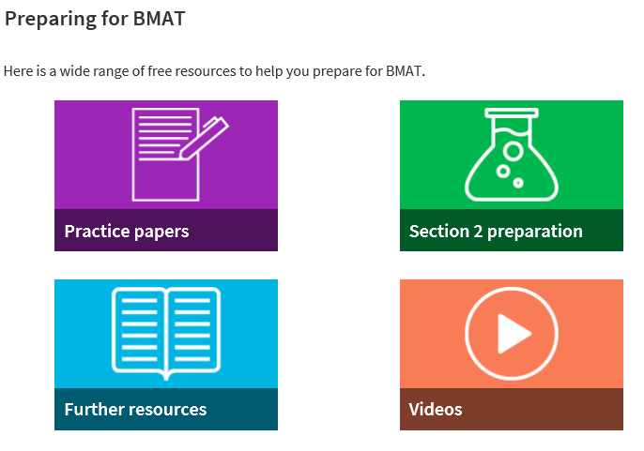
Preparing for BMAT: top tips
Use the free resources available on the BMAT website
https://www.admissionstesting.org/for-test-takers/bmat/preparing-for-bmat/

Slide 29
LMS Selection Process
Academic Excellence
    achieved and predicted grades
Medical Admissions Test
    (UCAT/BMAT)
Interview
  Personal Statement
Fitness to Practice
Academic criteria
Non-academic criteria

Slide 30
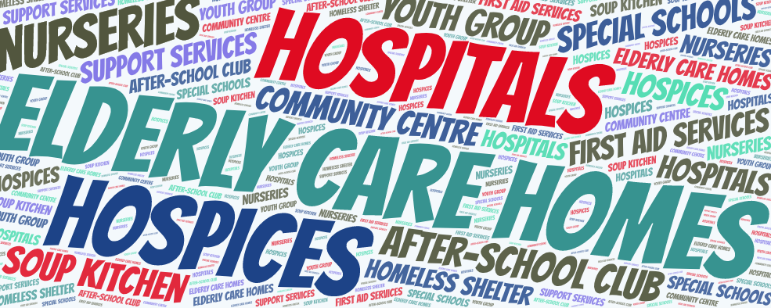
Work experience
Caring or service role with people particularly those who are ill, disabled or disadvantaged.
Medical schools want to see how your work experience has given you:
a realistic understanding of practising medicine
the attitudes and behaviours essential to being a doctor
experience of a caring role
https://www.medschools.ac.uk/media/2636/guidance-on-gaining-relevant-experience-for-studying-medicine-in-the-time-of-covid-19.pdf

Slide 31
Interview
To assess:
  motivation
  understanding of career choice
  personal skills, values & attitudes
  communication skills
Multiple mini interviews

Slide 32
Multiple mini interview (MMI)
1
Prep
2
3
Prep
Break
Applicants asked to perform a range of different tasks
Assessed against clearly defined criteria
Multiple interviewers / assessors
Prep
Prep
Break
4
Break
8
7
6
5

Slide 33

Example MMI Stations
Read and analyse
a PBL scenario
Interact with a member
of the public
Read a short
statement about an
ethical issue in
medicine & discuss
Short interview to
probe your
understanding of
your career choice

Slide 34
Fitness to Practice
All applicants must have the potential to function as a fully competent doctor and fulfil the rigorous demands of professional fitness to practice
http://www.gmc-uk.org/education/undergraduate/ professional_behaviour.asp

Slide 35
Fitness to Practice
Probity
Health:
  All disabilities and medical conditions must be disclosed on your application form as they may affect your ability to practise medicine
  Prospective medical students must be immunised for hepatitis B, MMR and tuberculosis.
Criminal Record:
  All medical students must be cleared by the Disclosure and Barring Service (DBS). Criminal convictions, cautions, reprimands and warnings etc must be declared on UCAS form.

Slide 36
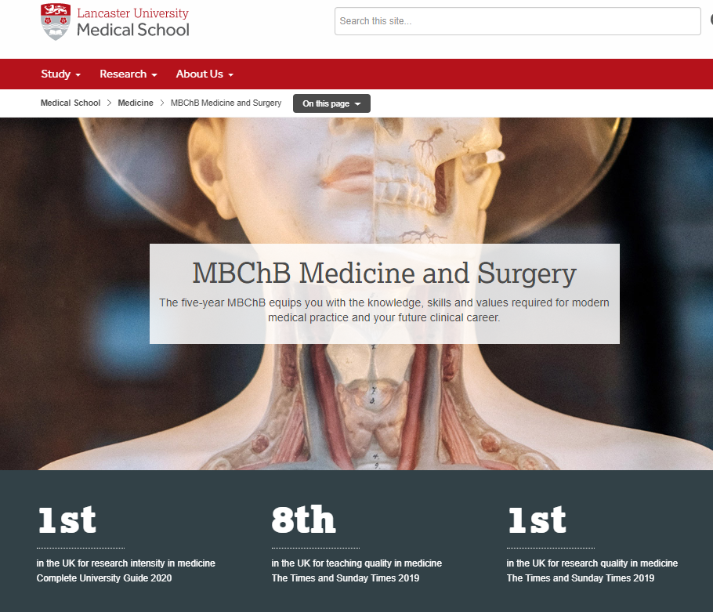
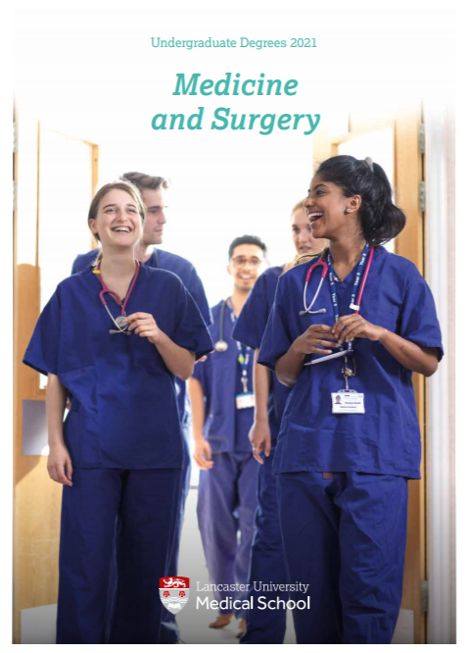
Resources – Lancaster Medical School
https://www.lancaster.ac.uk/lms/medicine/mbchb-medicine-and-surgery/

Slide 37
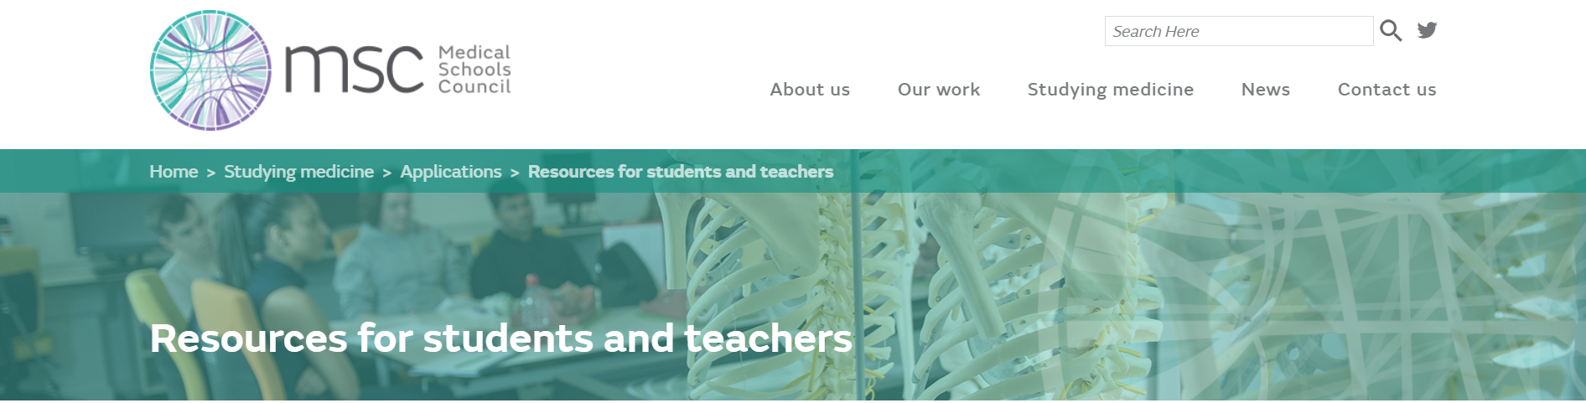
Resources - General
https://www.medschools.ac.uk/studying-medicine/
Lots of information written with UK Medical Schools
different types of medical education,
what its like working as a doctor,
how to apply to medical school,
how to prepare for medical school
etc.

Slide 38
Open Days Summer 2020
General
Online open days: 27th June, 11th July
- Find out about studying at Lancaster
- Speak to current students
- Subject talks and taster activities spread over following weeks
Open days: 12th September, 17th October
Activities TBC
https://www.lancaster.ac.uk/study/open-days/undergraduate-open-days/

Slide 39
Summary
Do your homework to identify medical schools that will suit you
Reflect on what you’ve learnt in your work experience
Check admissions requirements before you apply
Practice the BMAT before sitting!

Slide 40
Any questions?

Slide 41
Personal Statement
Reflect your experience, skills and attributes relevant to medicine.
Medical schools differ in their use of personal statements.
NOTE: IMAGE TO GO HERE
Important that:
it is written by you
it reflects you as a person
and is an honest reflection of your thoughts, skills and interests

Slide 42
Personal Statement
Applicants must demonstrate suitable evidence of:
Relevant work experience
Insight into a medical career and your suitability, drawn from your work (and voluntary) experience
An understanding of the NHS constitution and core values
A commitment to society: working for the benefit of others, including voluntary work or significant caring roles
Effective written communication skills: a coherent, well-structured personal statement

Slide 43
Admissions Statistics
 | 2015 | 2016* | 2017 | 2018 | 2019
Student places | 54 | 54 | 54 | 69 | 129
Applications | 1657 | 558 | 603 | 629 | 994
Interviewed | 220 (13%) | 246 (44%) | 243 (40%) | 282 (45%) | 557 (56%)
Offers | 114 (52%) | 113 (46%) | 123 (50%) | 150 (53%) | 286 (51%)
* 2016: introduction of BMAT to selection process

Slide 44
BMAT scores
 | A100
 | Range | Average
Applicants | 17.5 – 4.5 | 10.9
Invited to interview | 17.5 – 10.2 | 11.7
Offers | 16.6 – 10.2 | 11.8
Students | 14.3 – 10.3 | 11.5

