Slide 1
Problem Based Learning (PBL)
The what, where and how of PBL
Dr Nicola Phillips
Teaching Fellow & Admissions Tutor
Notes:
https://www.lancaster.ac.uk/lms/medicine/
https://www.lancaster.ac.uk/health-and-medicine/about-us/people/nicola-phillips

Slide 2
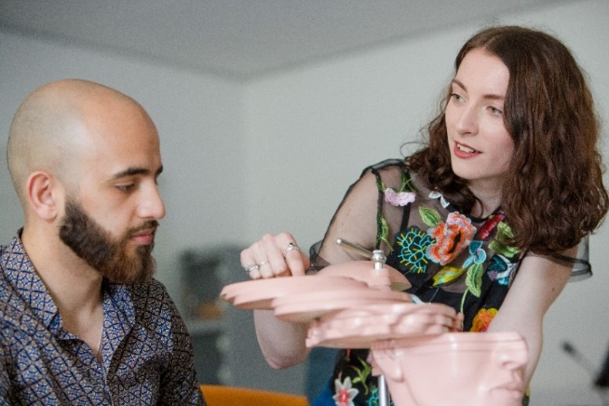
Introduction to PBL
1. Introduction Problem Based Learning
Differences between medical schools
Why PBL?
PBL – 7 steps @ Lancaster University
2. Self-study and taught sessions
Anatomy
Clinical Skills and placements
Communication Skills
3. Group Roles
Notes:
Problem Based Learning – the what, where and how of PBL. This 1hr webinar will introduce how Problem Based Learning (PBL) is used at Lancaster Medical School. Attendees will be able to explore and begin analysing a real PBL scenario and find out how this is used to stimulate learning across the breadth of subjects covered at Medical School.

Slide 3
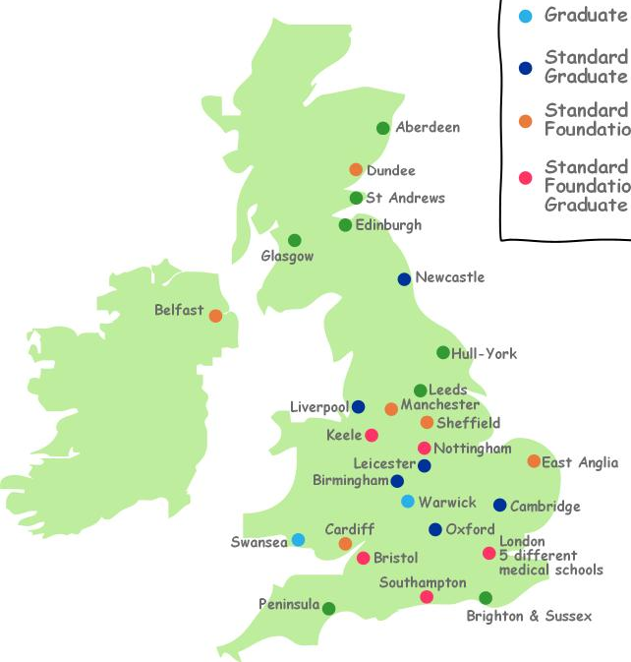
UK Medical schools
Medicine is different to other degrees:
Longer duration
Professional training
Experiential learning
Mastery of a breadth of subjects
Skills and knowledge
Sunderland
Lancaster
UCLan
Edgehill
Things to consider:
How they teach
Where they are
Entry requirements
Lincoln
Aston
Anglia Ruskin
Canterbury
Exeter
Plymouth
Standard course only
Standard and
Graduate courses
Standard, Foundation
& Graduate courses
Graduate course only
Standard and Foundation courses
New medical schools
Notes:
https://www.medschools.ac.uk/studying-medicine/medical-schools
https://www.medschools.ac.uk/studying-medicine/applications/entry-requirements
https://www.medschools.ac.uk/media/2371/msc-infosheet-med-school-differences.pdf

Slide 4
How is the teaching delivered?
Traditional:
Based at University for years 1+2 (+3)
Mostly lectures; subject-based
Clinical placement for years 3-5 (+6)
Problem-based learning:
Self-directed learning in small groups
Split into systems (learn “holistically”)
Earlier clinical exposure
Integrated curricula:
Mixture of lectures and small group teaching
Earlier clinical experience

Slide 5
What do our medical students learn?
PBL
Biomedical
Sciences
Public Health
Sociology
Of Health
Good Patient Care
Health
Psychology
Ethics &
Professionalism
Clinical
Skills
Communication
Skills
Notes:
https://www.lancaster.ac.uk/lms/medicine/mbchb-medicine-and-surgery/course-details/

Slide 6
What is Problem Based Learning?
PBL is an approach to learning
group work
problem is the stimulus for learning
Developed and researched at McMasters University, Canada between 1968-80
Widely used in medical education
Notes:
PBL is an approach to learning that was developed and researched at McMasters University, Canada between 1968-80 and is now widely used in medical education. This innovative approach followed a widespread recognition that the traditional approach to medical education, with an intensive pre-clinical period of basic science lectures followed by a clinical teaching programme was rapidly becoming ineffective. Traditional lectures did little to provide learners with a context for the application of knowledge, and the expansion of medical knowledge meant that medical curricula were becoming increasingly overloaded. In the UK, the General Medical Council stipulates that medical schools should design their curricula on the basis of current educational theory and research. PBL remains at the forefront of this field.

Slide 7
Key characteristics of PBL
Students must have responsibility for their own learning.
The problem scenarios should be complex.
Learning should be integrated from a wide range of disciplines or subjects.
Collaboration is essential.
Self-study must be applied back to the problem.
A closing analysis of what has been learned is critical.
Self and peer assessment should be regularly undertaken.
Notes:
The way PBL is used in different medical schools may vary, however, it should retain these key characteristics:
Learner motivation increases when responsibility for, and ownership of, the learning process rests with the learner. Learning is most effective when it is ‘active’.
Real world medical problems are rarely straightforward. A critical skill developed through PBL is the ability to identify the problem and design a set of objectives that lead to the development of a solution. Curiosity is a motivational force in learning.
Medical problems are multifaceted, accordingly medical practice involves the application of knowledge from a wide range of disciplines. Application of any one body of knowledge in isolation is unlikely to lead to a thorough understanding of the problem and provide an adequate resolution.
Clinical practice demands that doctors share information and work productively with others. PBL provides a format for the development of team-working and communication skills.
Individuals should share with the group what he/she has learned and how that information contributes to an understanding of the problem.
Reflection and evaluation consolidate the learning experience.
In addition to reflecting on the quality of knowledge developed over the course of the module, reflection on individual participation and group processes is also essential.
(Adapted from Savery, JR (2006) Overview of Problem-based learning: Definitions and Distinctions. Interdisciplinary Journal of Problem-based Learning, 1 (1): 9-20.)

Slide 8
PBL: a 7 step process
Obtain scenario overview
Explore scenario in detail
Discuss prior knowledge
Sort learning issues into curricular themes
Construct learning objectives
Self study
Feedback, discuss, evaluate
First Session
Notes:
Working through a PBL scenario effectively requires a methodical and detailed approach in order to reliably identify all the required areas of learning, formulate a set of learning objectives that will guide independent study, and provide an appropriate context for the discussion and consolidation of the learning that has taken place.
Lancaster Medical School uses a modified version of the Maastricht '7 steps' approach (Schmidt, H (1983) Problem based learning: rationale and description. Medical Education, 17(1): 11-16).

Slide 9
Obtain scenario overview
1
Read through the scenario
Understand scenario meaning
Clarify terms and concepts

Slide 10
Sweet Pee
Mrs Paula Sweet brings her 14 year old son, Peter, to see their GP, Dr Matt Dobson. She is concerned because he has lost some weight recently and looks a bit “scrawny”. She’s also noticed that he has been drinking a lot more than usual – and going to the loo all the time. Although Dr Dobson directs his questions to Peter, he is unforthcoming and Mrs Sweet answers for him.

Slide 11
Sweet Pee
She admits that Peter has been eating normally but complains that he seems to have lost interest in playing football, saying he doesn’t have the energy. Dr Dobson measures Peter’s height and weight and compares these to percentile charts, finding that he’s average height for his age (50% percentile) but his weight is below average (25% percentile). Dr Dobson tests a sample of Peter’s urine with a Clinistix strip and discovers that it contains glucose. Subsequent blood tests confirm that Peter has diabetes mellitus.

Slide 12
Sweet Pee
At a follow-up appointment, Dr Dobson explains to Peter that his pancreas is not working properly and, from now on, he will need to inject himself with insulin to help regulate his blood glucose. Peter reacts angrily and blurts out “No way! I am NOT going to inject myself”. Dr Dobson reflected that it was sometimes challenging to treat teenagers. Legally, Peter was a child but Dr Dobson still needed to respect his autonomy, and include him in the decisions made about his health.

Slide 13
Sweet Pee
Dr Dobson tries two approaches to persuade Peter to change his mind: exploring Peter’s concerns about injecting insulin and explaining the long-term health risks associated with uncontrolled diabetes.
Peter is referred to the diabetes clinic where he is given information about his diet and how to monitor his blood glucose. He also joins a support group for teenage diabetics and is relieved to find he is not the only one. Despite this, Peter still finds it difficult to come to terms with the fact that he has a chronic condition with which he will need to live for the rest of his life.

Slide 14
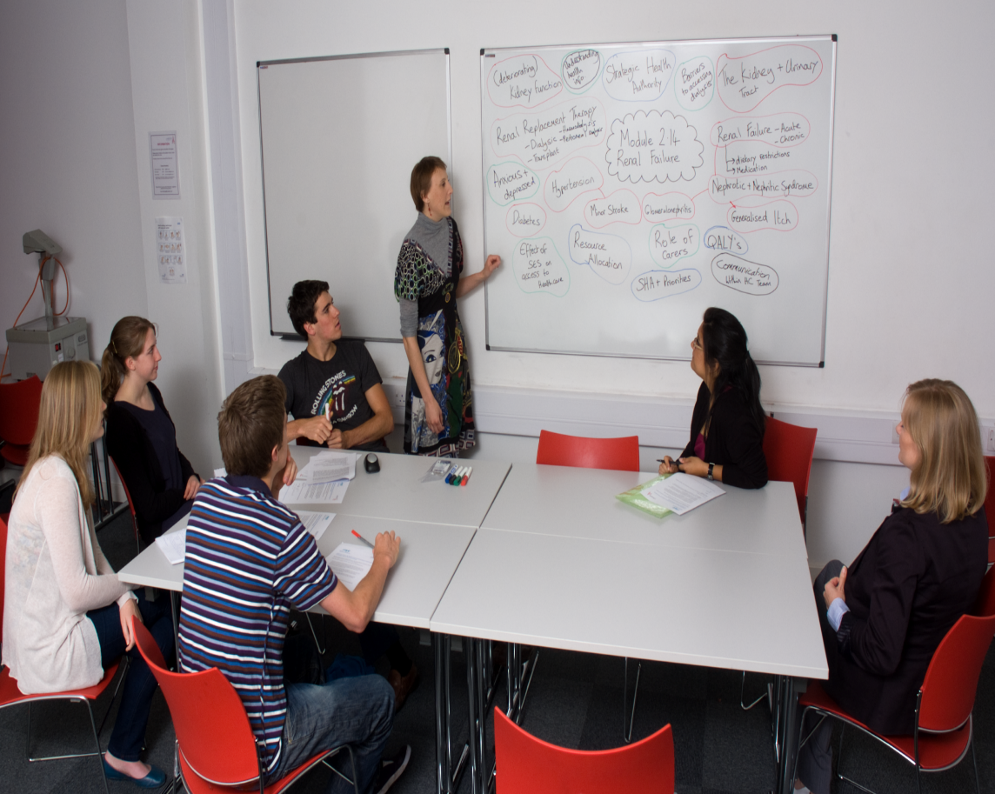
2. Explore the scenario in detail
Identify learning issues in each paragraph
terms
concepts
principles
Record on the board

Slide 15
Sweet Pee
Mrs Paula Sweet brings her 14 year old son, Peter, to see their GP, Dr Matt Dobson. She is concerned because he has lost some weight recently and looks a bit “scrawny”. She’s also noticed that he has been drinking a lot more than usual – and going to the loo all the time. Although Dr Dobson directs his questions to Peter, he is unforthcoming and Mrs Sweet answers for him.

Slide 16
Sweet Pee
She admits that Peter has been eating normally but complains that he seems to have lost interest in playing football, saying he doesn’t have the energy. Dr Dobson measures Peter’s height and weight and compares these to percentile charts, finding that he’s average height for his age (50% percentile) but his weight is below average (25% percentile). Dr Dobson tests a sample of Peter’s urine with a Clinistix strip and discovers that it contains glucose. Subsequent blood tests confirm that Peter has diabetes mellitus.

Slide 17
Sweet Pee
At a follow-up appointment, Dr Dobson explains to Peter that his pancreas is not working properly and, from now on, he will need to inject himself with insulin to help regulate his blood glucose. Peter reacts angrily and blurts out “No way! I am NOT going to inject myself”. Dr Dobson reflected that it was sometimes challenging to treat teenagers. Legally, Peter was a child but Dr Dobson still needed to respect his autonomy, and include him in the decisions made about his health.

Slide 18
Dr Dobson tries two approaches to persuade Peter to change his mind: exploring Peter’s concerns about injecting insulin and explaining the long-term health risks associated with uncontrolled diabetes.
Peter is referred to the diabetes clinic where he is given information about his diet and how to monitor his blood glucose. He also joins a support group for teenage diabetics and is relieved to find he is not the only one. Despite this, Peter still finds it difficult to come to terms with the fact that he has a chronic condition with which he will need to live for the rest of his life.

Slide 19
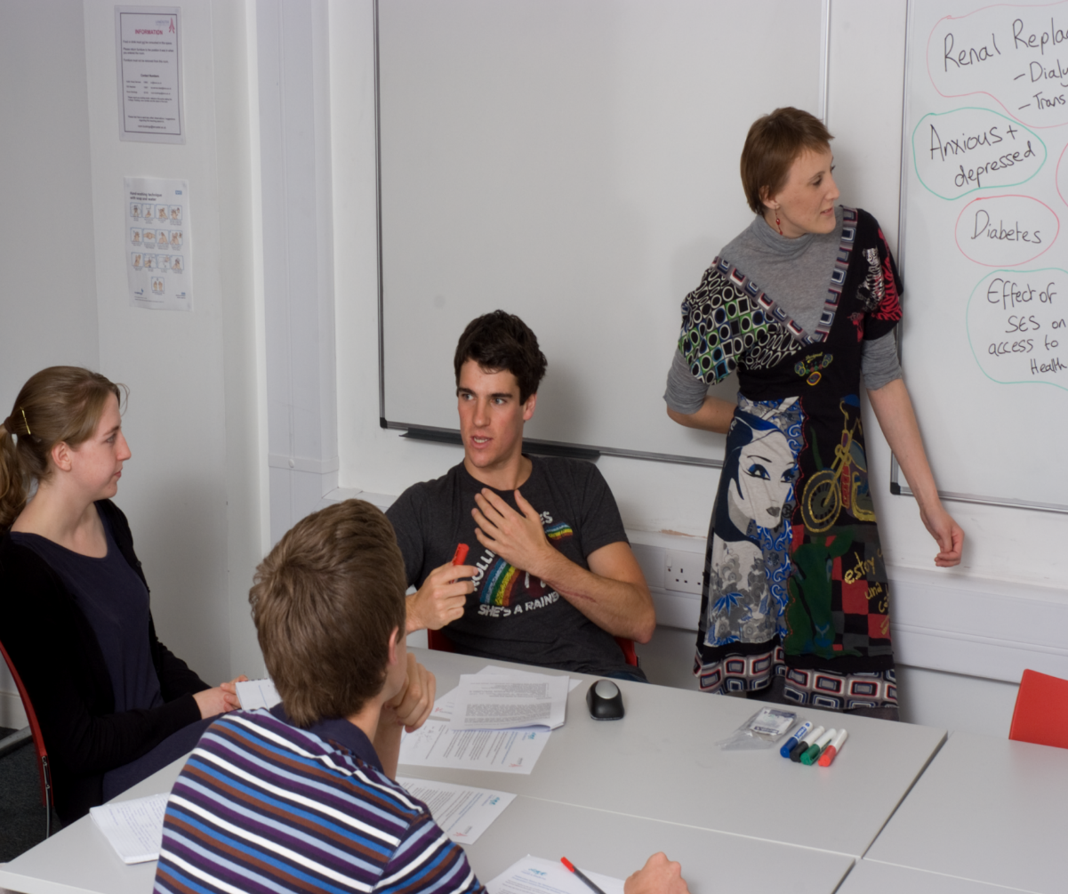
3. Discuss prior knowledge
As a group
Everyone contributes
Activates prior knowledge
Prepares brain to learn more
Notes:
It may come from previous study, media attention to health-related issues, or understanding may arise from personal experience (including that of family and peers).

Slide 20
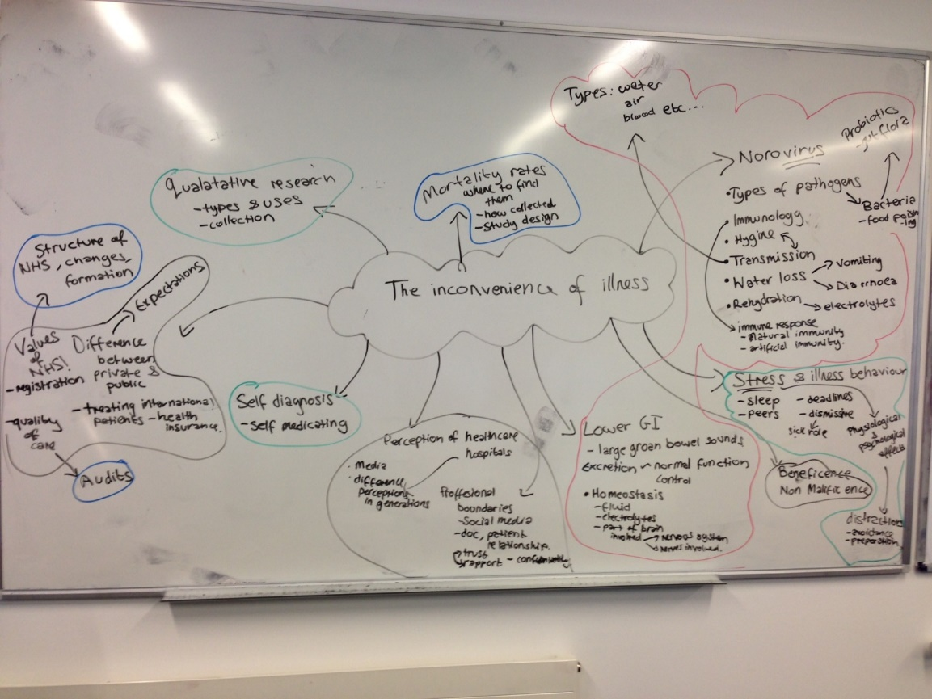
4. Sort learning issues into curricular themes
Scenarios are complex and multifaceted
Consider different perspectives
Clarifies and directs learning

Slide 21
Curricular Themes
Medical Sciences
Population Health
Health, Culture and Society
Professional Practice, Values and Ethics
Notes:
There are four themes running through the PBL curriculum. Each PBL module is designed to trigger learning in all four areas. This is to help you develop a comprehensive understanding of health-related issues and to highlight the relevant disciplines that inform medical science and practice. It is important to recognise, however, that the themes do not stand alone.
Medical sciences - the scientific knowledge that underpins a doctor’s understanding of normal and abnormal structure and function, how a disease can present and progress and how it can be investigated and managed. Initially this requires an understanding of the anatomy, physiology, immunology, biochemistry, microbiology and cellular and molecular biology of the healthy individual. As disease processes are explored, the underlying pathological processes, the pharmacology of therapeutic agents and the scientific basis of clinical investigations will also be considered.
Population Health - how ill health is distributed according to factors such as social and physical environments, distribution of power and wealth, health policies, even political contexts. This theme also addresses the means by which such health needs may be met and the organised efforts of a society to protect, promote and restore people's health. This theme will give you the tools, skills, and knowledge necessary to understand how health translates at a population level by drawing on many fields including: public health, infectious diseases, epidemiology and quantitative research methods.
Health, Culture and Society - Dimensions such as age, gender, ethnicity and socio-economic status are not incidental to health and illness but health and illness are patterned around these dimensions. The Health, Culture and Society theme urges you to consider the 'how and why' of these health inequalities. Drawing on the social and behavioural sciences helps you to understand how the ability of an individual to develop health-enhancing behaviours is subject to individual, cultural and societal constraints. This theme also considers how people have come to understand their illness, the sources of knowledge that have informed their understanding, and the different ways people experience and respond to illness.
Professional Practice, Values and Ethics - explores the factors that shape medical practice such as the professional guidance health professionals must adhere to, the law that sets the limits for medical practice, and how the attitudes of patients and health practitioners towards medicine have developed over time. This theme aims to furnish you with the tools to analyse ethically complex situations and aid decision making. By drawing on literature from the fields of medical ethics, law, history and professionalism, and asking you to think critically about clinical practice and the factors that shape it, this theme sharpens your ethical sensitivities, your analytical abilities and your awareness of the humanistic side of medicine.

Slide 22
5. Construct learning objectives
Scenarios incorporate an element of problem-solving.
Formulating LOs in unfamiliar disciplines is challenging.
As you learn more, formulating LOs becomes easier.
Examples:
MS: Describe the role of insulin in regulating blood glucose.
HCS: Explore the issues that patients commonly experience when managing their chronic illness.
PH: Understand percentiles to describe distributions
PPVE: Define the concepts of autonomy and consent.
Notes:
This can be more difficult at first than you might imagine. In Year 1, the ‘problem’ relates to which areas of study are indicated.

Slide 23
6. Self study
Direct own learning around learning objectives
Learning resources to aid study:
Recommended resource lists
Other scheduled activities
Lectures
CALC
Clinical skills
Be aware of your study habits
Notes:
Scheduled activities may go beyond the specific remit of a PBL module, but they will also be valuable in meeting the learning objectives.
and consciously develop approaches you find helpful (reading and making notes, for example, may be insufficient to allow for thorough discussion of a concept in the group).
Time around scheduled activities is meant for self-study.

Slide 24
A fortnight in the life of…
A Year 1 student at Lancaster Medical School
Year 1 = 11 x two-week modules
 | Monday | Tuesday | Wednesday | Thursday | Friday
Week 1 | Lecture PBL Self-study | Lecture Anatomy Self-study | Lecture (Workshop) (Sports) | Lecture Clinical skills Self-study | Lecture (Comms skills) Self-study
Week 2 | Lecture PBL Self-study | Lecture Anatomy Self-study | Lecture(s) (Sports) | Lecture Clinical Skills Self-study | Lecture PBL Self-study
All teaching sessions are linked to PBL module being studied this fortnight
Notes:
Course brochure – go to first year pages for explanation of timetable in more detail:
https://www.lancaster.ac.uk/media/lancaster-university/content-assets/documents/medical-school/WEB_MEDICINEANDSURGERY_2021.pdf

Slide 25
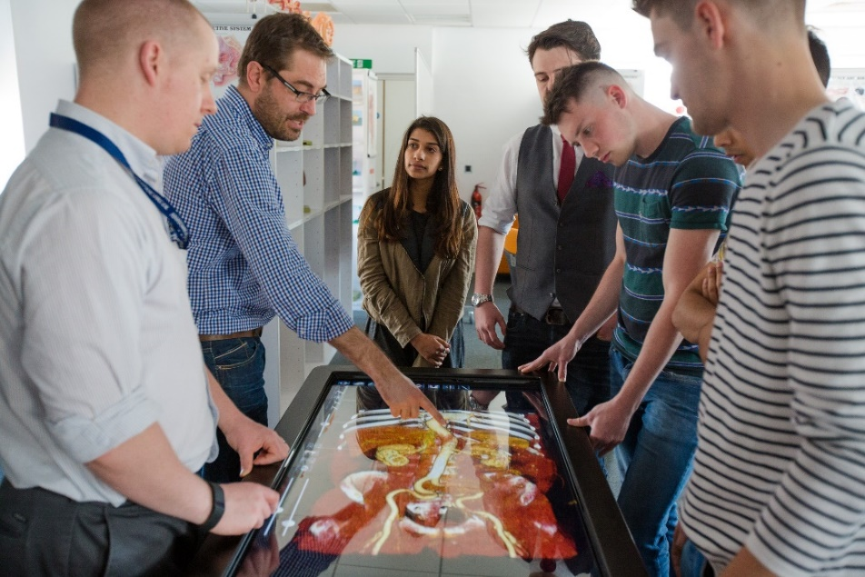
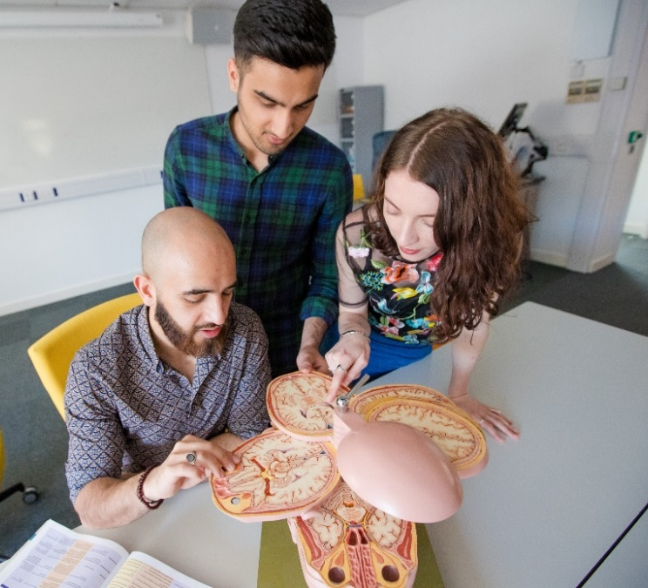
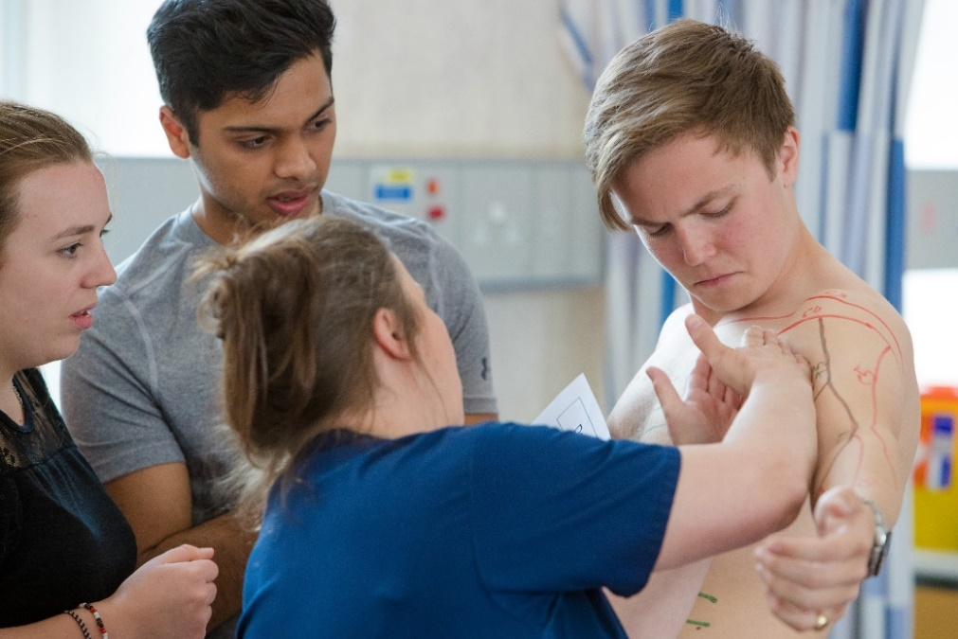
NOTE: IMAGE TO GO HERE
Anatomy
https://vimeo.com/345004661/2080f36f91
NOTE: IMAGE TO GO HERE
NOTE: IMAGE TO GO HERE

Slide 26
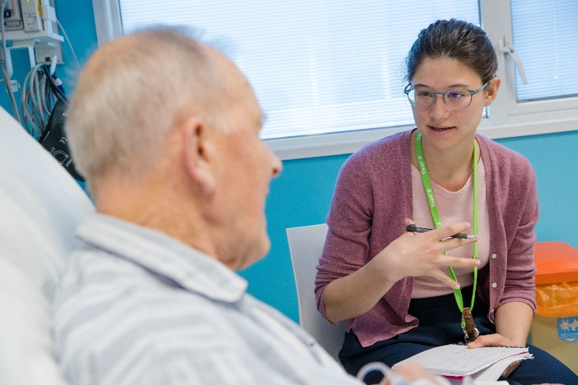
Communication Skills training
Practice communicating with peers
Discussion
Role play
Simulated patients
Constructive feedback
- including use of videoing

Slide 27
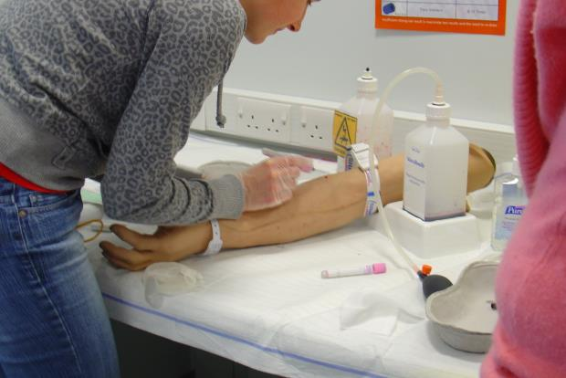
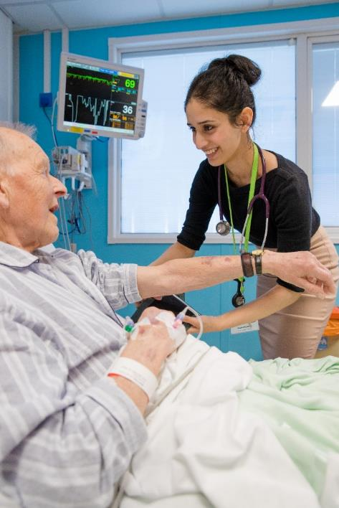
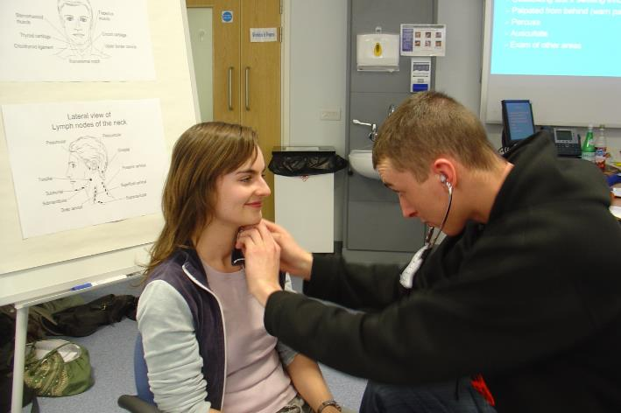
Clinical Skills

Slide 28
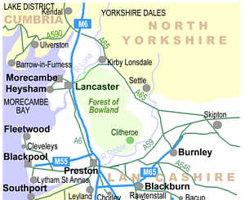
Clinical Placements
Westmorland
Hospital
Example image
Furness General
Hospital
X
Community Placements
in Lancashire & South Cumbria
Royal Lancaster
Infirmary
Royal Blackburn
Hospital
Blackpool
Victoria hospital
Notes:
https://www.lancaster.ac.uk/lms/medicine/mbchb-medicine-and-surgery/

Slide 29
FEEDBACK
Check what you’ve learnt
Teach other group members
Allows tutor to probe knowledge

Slide 30
7. Feedback, discuss and evaluate
Feedback on what has been learnt
without notes!
Evaluation
reflecting on the quality of learning
on group processes
on own participation
Notes:
Emphasis is on understanding and discussion rather than on repetition and rote learning.
Evaluation involves reflecting on the quality of learning that has occurred (eg, have the topics been studied to a sufficient depth?), on group processes (eg, how well did the group collaborate?), and on your own participation within these processes (eg, did I contribute enough to discussions?).

Slide 31
Where does PBL occur?
Year 1 and 2 – on campus with academic or clinical tutor (Monday and Friday)
Year 1 – focus on normal body function
Year 2 – understanding and recognising disease
Year 3 & 4: based entirely in clinical placement
PBL draws on current rotation with clinical tutor
Treating and managing disease

Slide 32
PBL encourages team work
Different roles within each team
Chair
Scribe
Other group members
Tutor
Notes:
Within a PBL group there are specific roles. All members of the group are expected to perform these roles at least once per term. These roles are detailed below and an indication given as to what they entail.

Slide 33
PBL roles: Chair
To move the group through the stages of the PBL process in a timely manner
To ensure a logical and comprehensive coverage of a topic
To encourage whole group participation

Slide 34
PBL roles: Scribe
Listens, records and organises information on the whiteboard
Contributes to discussion - the scribe is not a silent role
Only designated scribe in first session, everyone scribes as necessary in feedback sessions

Slide 35
PBL roles: Other group members
Contribute to discussions
Articulate knowledge
Contribute to the formation of learning objectives
Identify strengths, gaps and weaknesses in the group's knowledge

Slide 36
PBL roles: Tutor
Asks questions
to guide you to curriculum content
to challenge you to further articulate your knowledge
Encourages
engagement
effectively fulfil PBL roles
Facilitates reflective practice
ongoing self-reflection
evaluation of group performance
Notes:
In addition to student roles, there is a tutor. Tutors do not deliver information but do actively facilitate discussion.

Slide 37
PBL develops good
problem solving
teamwork
communication
study skills
Set own
Learning
Objectives
Scenario
Read &
Discuss
Reinforce learning
through discussion
Self
Study
Makes the student a life-long learner.

Slide 38
Problem Based Learning
Introduction to how PBL is run at Lancaster
Read and started to analyse a PBL scenario
Considered how LOs are written
Self study and taught sessions
Group roles
PBL
Self study
Lectures
Recommended resources
CALC
Communication skills
Clinical skills
Community placement

Slide 39
Thanks for listening, any questions?
Notes:
https://www.lancaster.ac.uk/lms/medicine/mbchb-medicine-and-surgery/
https://www.lancaster.ac.uk/media/lancaster-university/content-assets/documents/medical-school/WEB_MEDICINEANDSURGERY_2021.pdf

