Slide 1
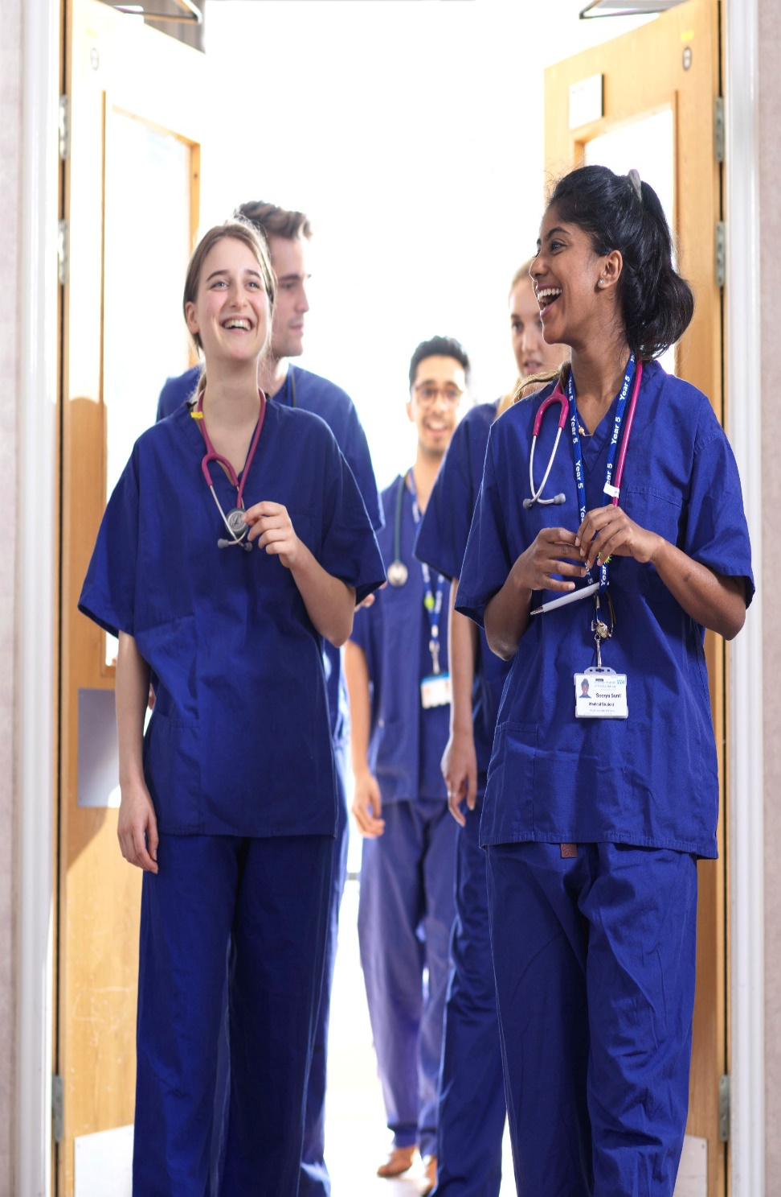

Preparing for the BMAT
Dr Nicola Phillips
Teaching Fellow & Admissions Tutor
Notes:
https://www.lancaster.ac.uk/lms/medicine/
https://www.lancaster.ac.uk/health-and-medicine/about-us/people/nicola-phillips

Slide 2
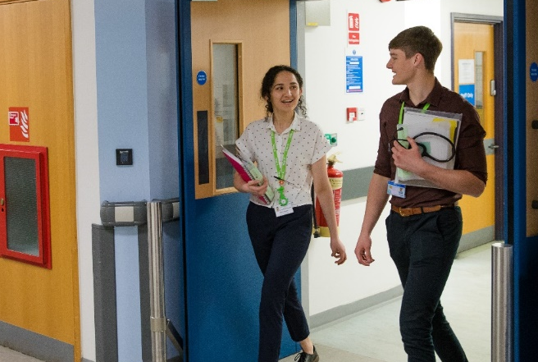
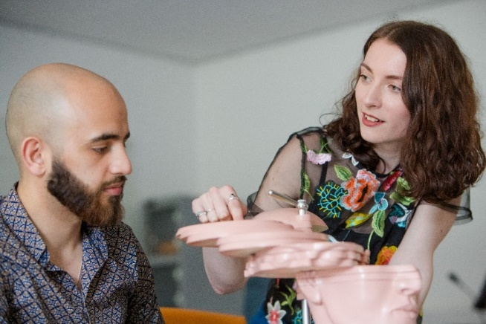
Preparing for the BMAT
1. Why and how do universities use BMAT?
2. Structure of the test
  How to access preparatory resources
  Types of questions
  Results analysis
  Preparation tips
3. Lancaster Medical School Admissions

Slide 3
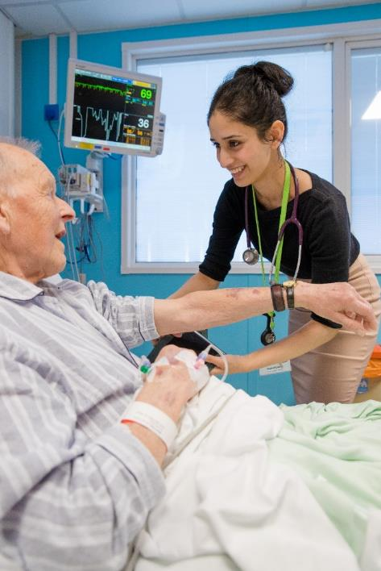
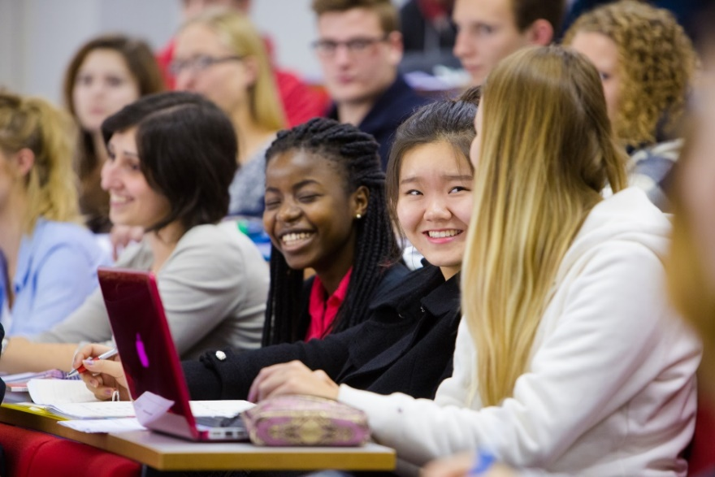

Medicine… it’s not like other degree courses
Notes:
Longer duration
Professional training
Experiential learning
Mastery of a breadth of subjects
Skills (clinical and communication) and knowledge

Slide 4

What are we looking for?
Well-rounded individuals
Thoughtful, caring and compassionate
Insightful
Values
Motivated and conscientious
Academically able
Resilient

Slide 5
LMS Selection Process
Academic Excellence
    achieved and predicted grades
Medical Admissions Test
    BMAT
Interview
    Personal Statement
Fitness to Practice
Academic criteria
Non-academic criteria
Notes:
We select for your academic ability as well as your aptitude, skills and understanding of a medical career through a number of methods.

Slide 6

Admissions Tests
Select for mental abilities, attitudes and professional behaviours
  Decide whether to invite a student to interview
  Inform whether an offer should be made
  Decide between two equally ranked applicants
Only sit once a year, each year you apply you’ll need to retake the test
Test fee bursary available for students from low income households.
University Clinical Aptitude Test (UCAT formerly UKCAT)
Biomedical Admissions Test (BMAT)

Slide 7
COVID19 updates
UCAT have a COVID19 update page
Cambridge Admissions Testing have a COVID19 update page
Prepare as you would normally have done
As School/College situations for summer term become clearer, testing organisations will be able to make decisions

Slide 8
Admissions Tests
 | UCAT | BMAT
Duration | 2 hours
Sections | 5 | 3
How | Computer based | Pen and paper
Registration date | May to mid-September | Mid-June to mid-Aug | September
Test date | July to October | September | November
Where | Test centre | Test centre | Test centre or school

Slide 9
BMAT
Key dates (for 2021 entry):
BMAT August
  Register: 22nd June – 9th August 2020
  BMAT Sept: 5th September 2020 (~20 test centres in UK)
  BMAT results: 25th September 2020 – to test takers only
https://www.admissionstesting.org/for-test-takers/bmat/bmat-september/dates-and-costs/
BMAT November
  Register: 1st September - 1st October 2020
  Late registration: before 15th October 2020
  BMAT test: 4th November 2020 (in school, college or test centre)
  BMAT results: 27th November 2020
https://www.admissionstesting.org/for-test-takers/bmat/bmat-november/dates-and-costs/

Slide 10
Access Arrangements
For candidates who are entitled to support for other exams
  disability, special requirement
Standard arrangements include
  extra working time - supervised rest breaks
  enlarged question papers
  a reader, a laptop, Braille papers
Candidate should inform the test centre ASAP
Test centre will ask for
  full details of their requirement
  supporting medical evidence.
https://www.admissionstesting.org/Images/325523-access-arrangements.pdf

Slide 11
Bursary
Standard fees can be reimbursed if you match certain criteria
  Not late entry or administration fees
Apply before 15th October 2020
  Fill out reimbursement application form
  Upload supporting evidence
Candidate in receipt of
  16 – 19 bursary - Learner Support
  Education Maintenance Award - free school meals
Parent or guardian in receipt of
  Income Support - Employment and Support Allowance
  Child Tax Credit - Universal Credit
https://www.admissionstesting.org/for-test-takers/bmat/bmat-november/dates-and-costs/

Slide 12
Myth busting
Myth One: You need to be studying A-level Maths & Physics
No, the knowledge assessed in Section 2 is based on GCSE Science & Maths but the style of question is different
Myth Two: BMAT is super-difficult
If you are good at science, you will probably be good at BMAT
Myth Three: You need to pay for an expensive preparation course to be able to get a good BMAT score
No, there is no evidence that attending a course improves applicants’ scores. All you need to help you prepare can be found, FOR FREE, on the BMAT website

Slide 13
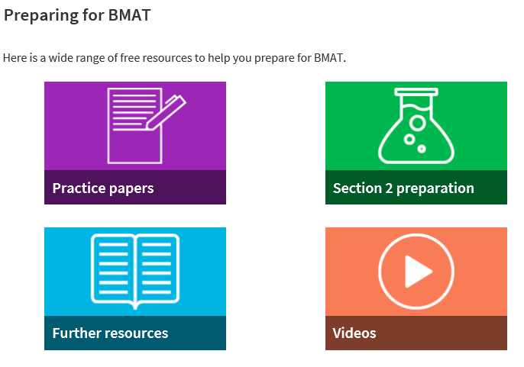
Preparing for BMAT: top tips
Use the free resources available on the BMAT website
https://www.admissionstesting.org/for-test-takers/bmat/preparing-for-bmat/

Slide 14
BMAT
Section 1 – Thinking Skills
problem solving, critical thinking.
Section 2 - Scientific Knowledge and Applications
application of scientific knowledge (Key stage 4 Science and Maths)
Section 3 - Writing Task
- ability to select, develop and organise ideas, and communicate them in writing in a concise and effective way
Think about the types of questions in each section
Practice some questions under timed conditions
Look at average scores for each section

Slide 15
Section 1 – Thinking Skills
Tests generic skills
problem solving – reasoning using numerical skills
critical thinking – reasoning using everyday written language
1 hr, 32 questions
Marked out of 9
No calculator or dictionary
Ordered in increasing difficulty, interspersed Q type

Slide 16
Section 1 - Practice
TASK 1
Try three types of questions
1 minutes 52s
First question: problem solving
Second question: understanding argument
Third question pattern recognition
Data Analysis and Inference questions no longer included – be aware when using past papers – change occurred this year

Slide 17
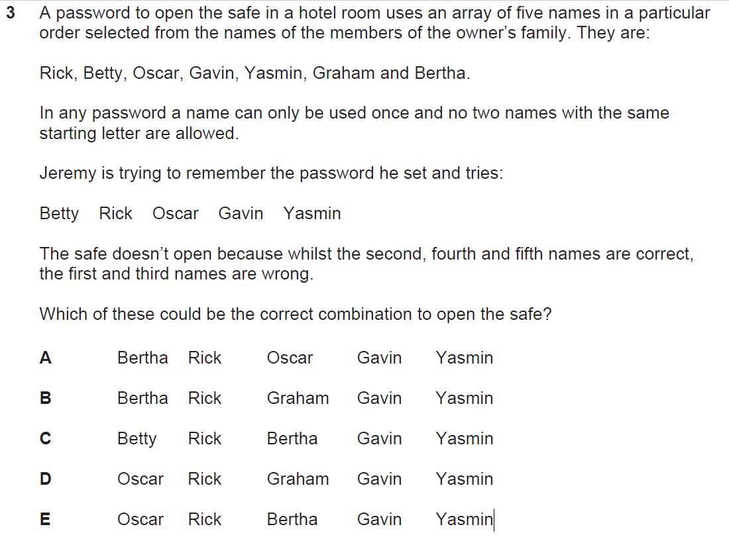
Section 1 - Practice
Notes:
3 E
Since the second, fourth and fifth names are correct, it is only the possible names for the first and third positions that need to be worked out. Since names cannot be repeated and no two names can have the same first letter, the only options left are Bertha, Betty and Oscar. Since the two names cannot be both Bertha and Betty, one of the names must be Oscar, and this must be in the first position since we know that Oscar was wrong in the third position. This leaves only two possibilities for the code:
Oscar Rick Bertha Gavin Yasmin
Oscar Rick Betty Gavin Yasmin
Betty is not given as an option in the answer options. E is therefore the correct answer. Alternatively, a quick strategy to answer this question is to eliminate the options. We know that the password cannot have more than one name with the same starting letter, so B (Graham and Gavin), C (Betty and Bertha) and D (Graham and Gavin) can be eliminated. We also know that Betty in first place and Oscar in third place are incorrect, so we can eliminate A (which has Oscar in third place) and C again (which has Betty in first place). So the only possible combination is E.

Slide 18
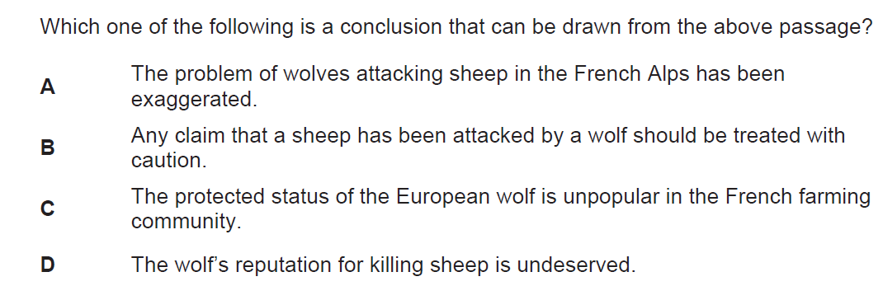
4. Since the late 1990s wolves have been seen in the Haute-France region of the Alps.
This places them once again in conflict with the shepherds who farm this region. Due to the protected status of the European wolf, French farmers are awarded a
compensation payment for the loss of any of their sheep to a wolf. This payment
amounts to considerably more than the livestock value of the animal. In addition to this, it is very difficult to distinguish between evidence of a wolf attack and dog attack. France has a population of 8 million dogs; 8 000 of these are estimated to be wild compared to only 200 wolves.
Notes:
4 B
Here we have a passage where we are given nothing but a series of claims that are largely factual. None of them are claims that sound like judgments that demand further support – and in fact we are not given any. This kind of passage is likely to be used for a ‘drawing a conclusion’ question, since no actual conclusion, and therefore no argument, has been presented. (The author has not used any of the pieces of information to make a point; they are just presenting us with the information.) The task in ‘drawing a conclusion’ questions is to infer or deduce what can logically follow from the information
provided.
In these questions, the key to getting the right answer is being careful. In particular, you must ensure that you do not conclude more than the passage allows. You also need to make sure that the conclusion you draw is consistent with, and supported by, the passage as a whole – not just a particular claim it makes.
Here, the information tells us: (1) that wolves are making a return to a region of France; (2) that farmers are rewarded compensation for sheep attacked by wolves; (3) that this is considerable; (4) that it is very difficult to distinguish between wolf and dog attacks; and (5) that there are many more
wild dogs than wolves.
Putting these points together makes a case for thinking that farmers have a clear motive to make bogus claims about wolf attacks. After all, they are likely to be rewarded for such fake claims and are unlikely to get found out as being dishonest. Indeed, because there is such a greater number of wild
dogs and it is difficult to distinguish between wolf and dog attacks, there is a strong likelihood that sheep losses attributed to wolves – purposely misleadingly or otherwise – are in fact caused by dogs.
From this line of reasoning it follows that any claim that a sheep has been attacked by a wolf in the Haute-France region should be treated with caution. Therefore, B is a conclusion that can be drawn from the passage. The other three options (A, C, D) go beyond what is supported by the information
presented.

Slide 19
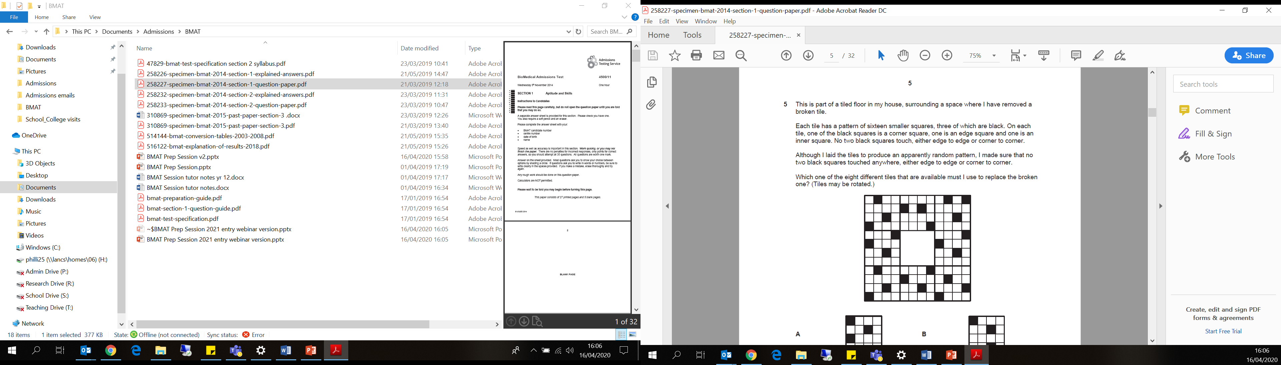
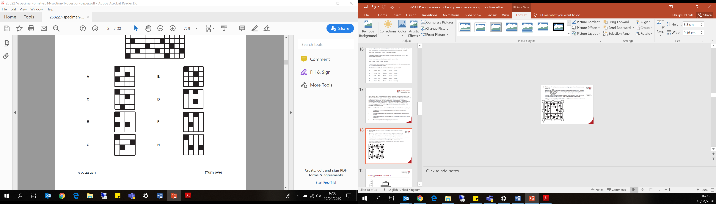
Notes:
5 G
With this type of question, there is normally a small number of necessary criteria that one must meet. Here, as no black squares can be touching (edge to edge or corner to corner) and we are placing the central tile, it is only the squares immediately surrounding the middle square that will determine which
tile could be placed in the middle.
The squares shaded in yellow cannot be the ones that should be black as they would share an edge or corner with another black square. This means that the two squares shaded in blue must be ones that should be black. Once this is determined, it is possible to eliminate the squares that are green, as
they touch the blue squares, so there is only one possible tile that fits the criteria.
To match it to the options, it is easiest to start with one square as a reference – for example, the ‘edge square’ is on the side clockwise round from the ‘corner square’ and in the nearer position of the two to the ‘corner square’. Once those two squares are checked, there is only one position for the final
square that fits the requirements.
G is therefore the correct answer.

Slide 20
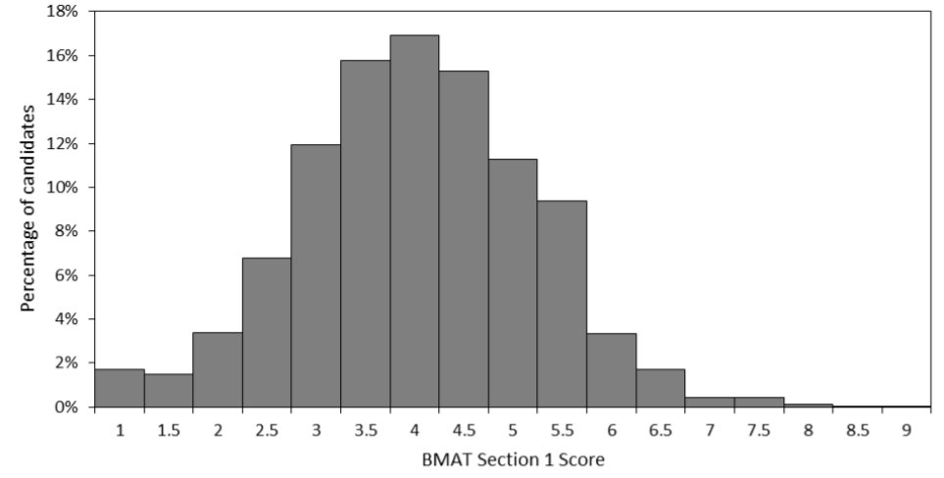
Average scores section 1 (2018)
29 – 37%
63%
>80%
54%
Notes:
2018 BMAT scores

Slide 21
Section 2 - Scientific Knowledge and Applications
Tests application of knowledge in:
Biology, Chemistry, Physics, Mathematics
At GCSE level
30 minutes, 27 questions
Marked out of 9
No calculator or dictionary allowed
Cover most of the material in GCSE
Require you to apply your knowledge to situation
Can seem difficult but the test is used to separate very able candidates
Notes:
Please note that as curriculums have changed over time, so has the Science and Mathematics content of BMAT Section 2. The BMAT Section 2 content specification has been revised for testing from August 2019 onwards. Questions in the practice papers marked with an asterisk assume knowledge that is not currently on the specification.

Slide 22
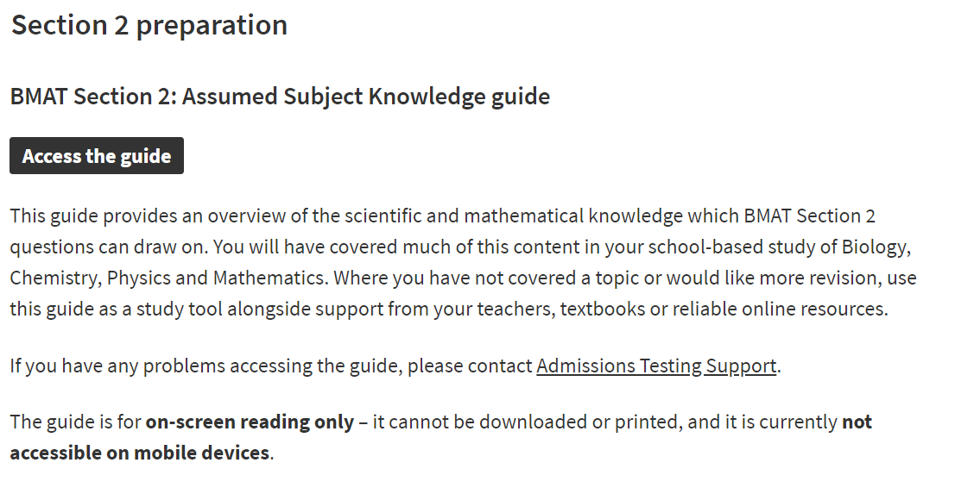
Section 2 - Practice
Notes:
Section 2 syllabus can be see in test specification (make sure you use the up-to-date specification): https://www.admissionstesting.org/Images/535824-bmat-test-specification.pdf
Section 2 subject guide: https://www.admissionstesting.org/for-test-takers/bmat/preparing-for-bmat/section-2-preparation/

Slide 23
Section 2 - Practice
The following statements relate to the flow of blood through the heart.
1 Oxygenated blood flows through the right side of the heart.
2 The vena cava empties deoxygenated blood into the ventricle.
3 The heart pumps oxygenated blood through the pulmonary artery.
4 There is a valve that prevents backflow of blood from the aorta into the left ventricle.
Which of these statements is/ are correct?
D: 1 and 3 only
E: 1 and 4 only
F: 1, 2 and 3 only
G: 2, 3 and 4 only
A: 1 only
B: 2 only
C: 4 only
Notes:
SECTION 2 Answer C
Statement 1 is incorrect because deoxygenated blood flows through the right side of the heart.
Statement 2 is incorrect because blood from the vena cava enters a top chamber which is an atrium.
Statement 3 is incorrect because the pulmonary artery is one of the few arteries that carries deoxygenated blood.
Statement 4 is correct because there are valves in the base of the aorta to prevent the backflow of blood into the ventricle, when the ventricle relaxes.

Slide 24
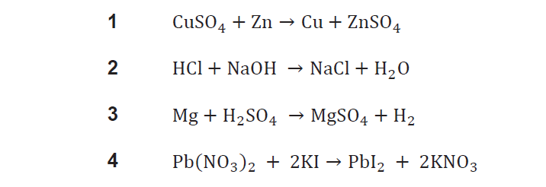
Section 2 - Practice
2 Which of the following reactions are redox reactions?
A: 1 and 2 only
B: 1 and 3 only
C: 1 and 4 only
D: 2 and 3 only
E: 2 and 4 only
F: 3 and 4 only
Notes:
Explanation and answer
Reaction 1 is a redox reaction because there are changes in oxidation states (ionic charges): the
oxidation state of copper changes from +2 to 0 (Cu2+ + 2e– → Cu [reduction]), and zinc changes from
0 to +2 (Zn → Zn2+ + 2e– [oxidation]).
Reaction 2 is not a redox reaction because there is no electron transfer (no change in ionic charge,
nor oxidation state).
Reaction 3 is a redox reaction because there are changes in oxidation states (ionic charges): the
oxidation state of magnesium changes from 0 to +2 (Mg → Mg2+ + 2e– [oxidation]), and hydrogen
changes from +1 to 0 (2H+ + 2e– → H2 [reduction]).
Reaction 4 is not a redox reaction because there is no transfer of electrons.
The answer is B

Slide 25
Section 2 - Practice
3 Below are four statements about electromagnetic radiation.
  1 Microwaves have a shorter wavelength than all other electromagnetic waves.
  2 For identical amplitudes, waves with the largest wavelength transfer the most energy.
  3 The speed of electromagnetic waves is inversely proportional to their frequency.
  4 Ultraviolet radiation can cause cataracts.
Which of these statements is / are correct?
A: 1 only
B: 2 only
C: 3 only
D: 4 only
E: 1 and 3 only
F: 1 and 4 only
G: 2 and 3 only
H: 2 and 4 only
Notes:
Explanation and answer
Statement 1 is incorrect; microwaves have a longer wavelength than infrared radiation and many
other parts of the electromagnetic spectrum.
Statement 2 is incorrect; energy increases with frequency (and consequently decreases with
wavelength), and so in fact the shortest wavelengths transfer the most energy.
Statement 3 is incorrect; the wavelength is inversely proportional to frequency, and the speed is the
constant for this relationship (𝑣 = 𝑓 × 𝜆).
Statement 4 is correct; ultraviolet waves are higher frequency than visible light, so carry more energy
and can damage corneas, causing cataracts.
The answer is D

Slide 26
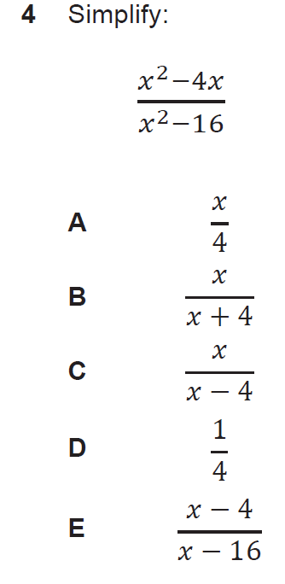
Section 2 - Practice
4. B
𝑥²−4𝑥
𝑥²−16
= 𝑥(𝑥−4)
(𝑥+4)(𝑥−4)
= __𝑥__
(𝑥+4)
Notes:
4 minutes 26 seconds
SECTION 2 Answer C
Statement 1 is incorrect because deoxygenated blood flows through the right side of the heart.
Statement 2 is incorrect because blood from the vena cava enters a top chamber which is an atrium.
Statement 3 is incorrect because the pulmonary artery is one of the few arteries that carries deoxygenated blood.
Statement 4 is correct because there are valves in the base of the aorta to prevent the backflow of blood into the ventricle, when the ventricle relaxes.

Slide 27
Section 2 preparation tips
Look through the syllabus
think about what topics you’ve already covered in GCSE and what is to come
Make sure your notes are useful
Get your notes sorted back in order after you’ve finished your GCSE
Practice subjects you don’t study
If you drop a subject at A’ level, spend more type going over this before you start working through practice papers
Prepare for questions on the current specification
Section 1 updated this year
Section 2 updated 2019

Slide 28
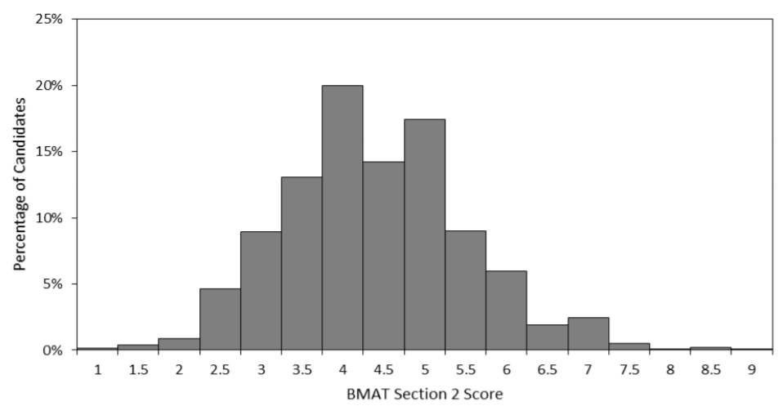
Average scores section 2 (2018)
33 – 44%
70%
59%
>89%

Slide 29
Sitting the BMAT:
Sections 1 & 2 top tips
Time management
Try not to spend more than 2 minutes per question Section 1
1 minute/ question Section 2
Skip questions you’re stuck on and come back
Eliminate options to help you narrow best guesses
Answer every question even if it is a guess
Underline key words and numbers
Use the question paper for your workings

Slide 30
Section 3 - Writing Task
Tests application of knowledge in:
Biology, Chemistry, Physics, Mathematics
30 minutes, choose 1 question from 3
Topics general, medical or scientific interest
Qs provide short proposition and may require you to:
Explain or discuss the implications
Suggest a counter proposition/argument
Suggest a method to resolve the issue
Responses restricted to single side answer sheet
Marked on quality of content (/5) and English (A-E).

Slide 31
Section 3 - Writing Task
There is more to healing than the application of scientific knowledge
Briefly define ‘scientific knowledge’. Explain how it might be argued that medical treatment that is not wholly based on scientific knowledge is worthless. Discuss whether there can be approaches to healing that are valid but not amenable to scientific experiment.

Slide 32
Section 3 - Writing Task
There is more to healing than the application of scientific knowledge
Briefly define ‘scientific knowledge’.
Explain how it might be argued that medical treatment that is not wholly based on scientific knowledge is worthless.
Discuss whether there can be approaches to healing that are valid but not amenable to scientific experiment.
What do you know about this topic and how you could start to plan an answer

Slide 33
Section 3 - Writing Task
There is more to healing than the application of scientific knowledge
Briefly define ‘scientific knowledge’.
Explain how it might be argued that medical treatment that is not wholly based on scientific knowledge is worthless.
Discuss whether there can be approaches to healing that are valid but not amenable to scientific experiment.
What is the difference between scientific and other knowledge?
How are medical treatments discovered, validated, authorised for use?
Can you think of ways to heal someone that aren’t scientific?

Slide 34
Section 3 – On the day
Choose question you find most interesting
Plan response carefully before you start writing
  Use question paper not answer sheet
Be clear and concise
  You have a limited amount of space
Show that you can consider different sides of an issue
Answer all parts of the question
Only include material of direct relevance to question
Make sure your answer is contained within the box on the answer sheet

Slide 35
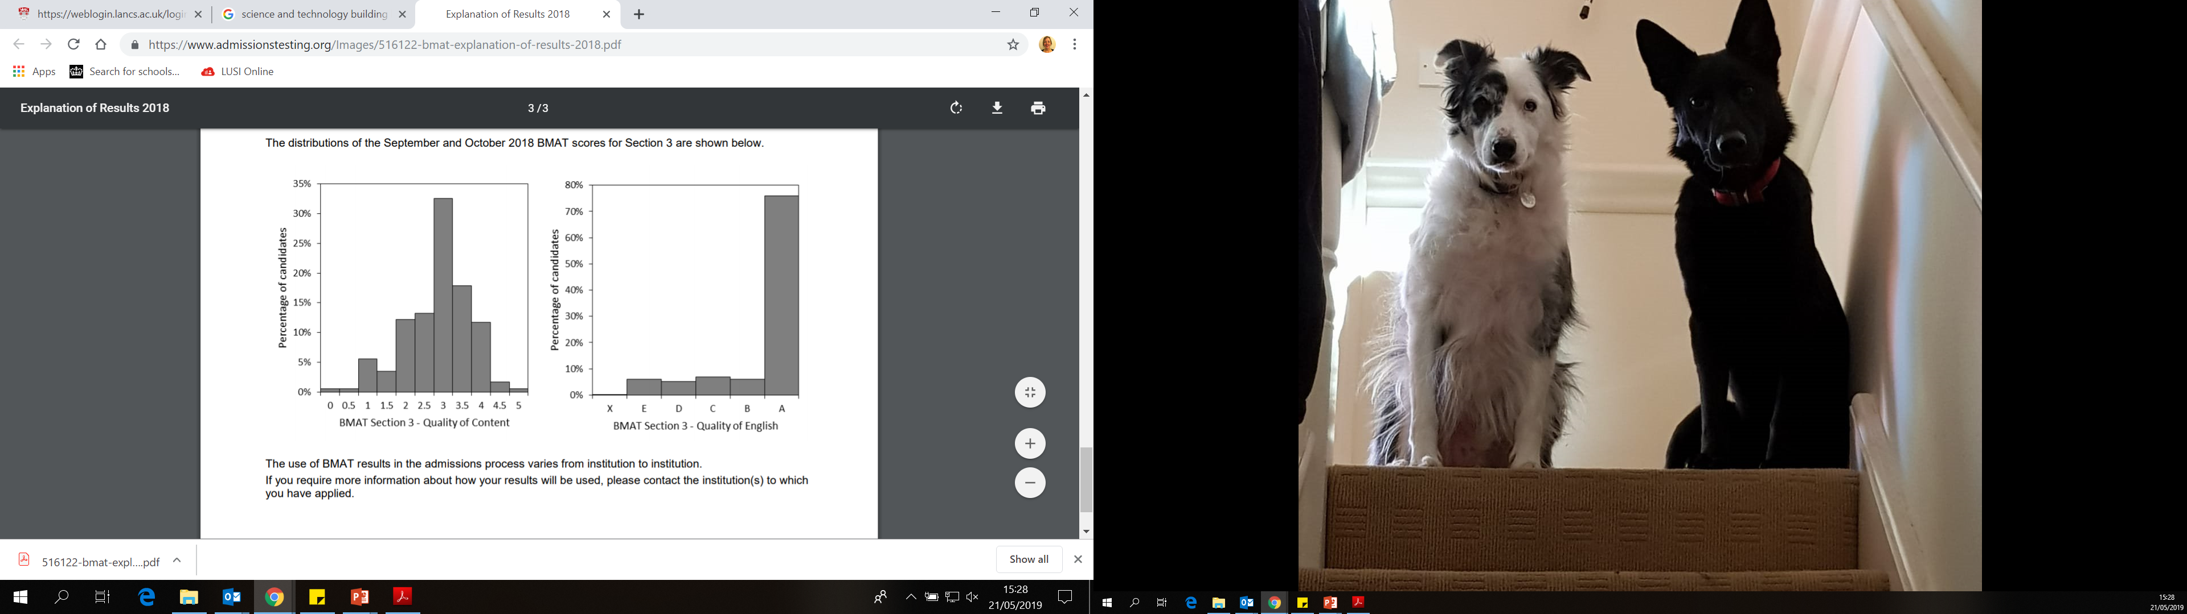
Average scores section 3 (2018)
Notes:
Oxford/Cambridge don’t use it

Slide 36
BMAT
Section 1 – Thinking Skills /9
problem solving, critical thinking.
Section 2 - Scientific Knowledge and Applications /9
application of scientific knowledge (Key stage 4 Science and Maths)
Section 3 - Writing Task /5
- ability to select, develop and organise ideas, and communicate them in writing in a concise and effective way
TOTAL = /23
Ranking according to BMAT score will determine who gets invited to interview

Slide 37
Example BMAT scores LMS: /23
 | A100
 | Range | Average
Applicants | 17.5 – 4.5 | 10.9
Invited to interview | 17.5 – 10.2 | 11.7
Offers | 16.6 – 10.2 | 11.8
Students | 14.3 – 10.3 | 11.5
4 + 4 + 3.5
3.5 + 5 + 3
5 + 5 + 2
45-62%
Notes:
https://www.lancaster.ac.uk/lms/medicine/mbchb-medicine-and-surgery/how-to-apply/#how-we-use-the-biomedical-admissions-test-bmat-in-our-selection-process

Slide 38
Preparing for BMAT: top tips
Use the free resources available on the BMAT website
https://www.admissionstesting.org/for-test-takers/bmat/preparing-for-bmat/
Practice all three sections
Don’t be tempted to ignore section 3.
Practice under timed conditions
Section 1: 32 MCQs (60 mins)
Section 2: 27 MCQs (30 mins)
Section 3: choice from 3 topics (30 mins)
On average, applicants spend ~30 hours preparing for BMAT
And there’s no evidence that spending longer results in better scores…

Slide 39

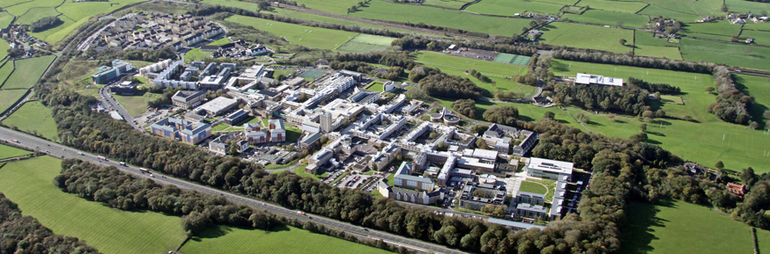
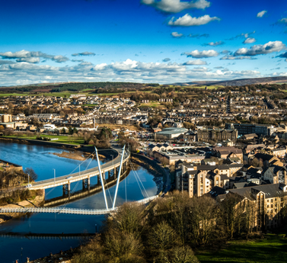
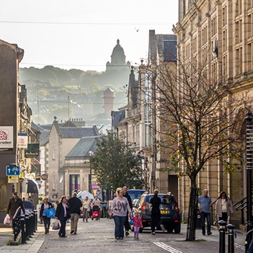
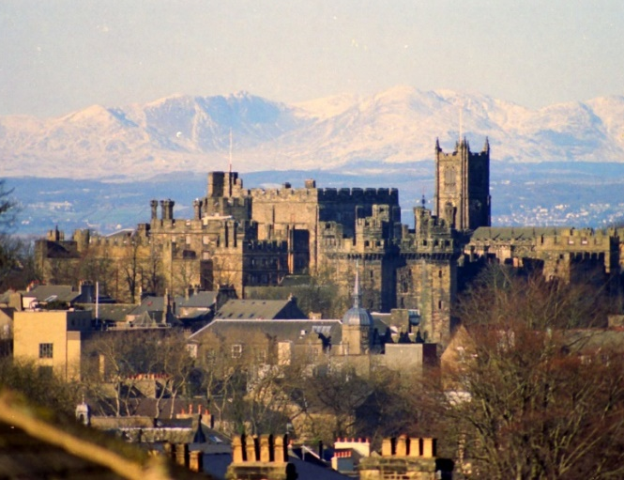
Thanks for listening, any questions?
Notes:
https://www.lancaster.ac.uk/lms/medicine/

Slide 40
Academic entry criteria
Academic excellence:
GCSE: in nine subjects, 6-9s, including
  Science (Core & Additional or Biology, Chemistry and Physics),
  English Language and
  Maths
A-LEVELS: AAA-AAB (for 2020)
Must include two of Biology, Chemistry or Psychology
Third A-level can be any academic subject
AAB 3 A Levels + EPQ @ B
Notes:
https://www.lancaster.ac.uk/lms/medicine/mbchb-medicine-and-surgery/entry-requirements/

Slide 41
Widening Participation
Meet our WP criteria?
Predicted AAB or above
Predicted BBB - ABB
A100
A900
Standard offer
AAB - AAA
WP offer
ABB
Standard offer
ABB
May be confirmed on lower grades
Notes:
Contextual offer scheme: https://www.lancaster.ac.uk/lms/medicine/mbchb-medicine-and-surgery/entry-requirements/#d.en.409326
Foundation year for Medicine and Surgery: https://www.lancaster.ac.uk/lms/medicine/foundation-year-for-medicine-and-surgery/

Slide 42
A100:
Contextually lowered offers
For certain applicants who fulfil widening participation criteria
  Dual offer: AAA or
  ABB if they make Lancaster Medical School their FIRM choice and attend a post-offer event.
Example of widening participation criteria:
  Low income household
  School context: non-selective state; Attainment 8 score
  First in family to attend university
  Refugee, local authority care leaver, young carer
Notes:
https://www.lancaster.ac.uk/lms/medicine/mbchb-medicine-and-surgery/entry-requirements/#d.en.409326

Slide 43
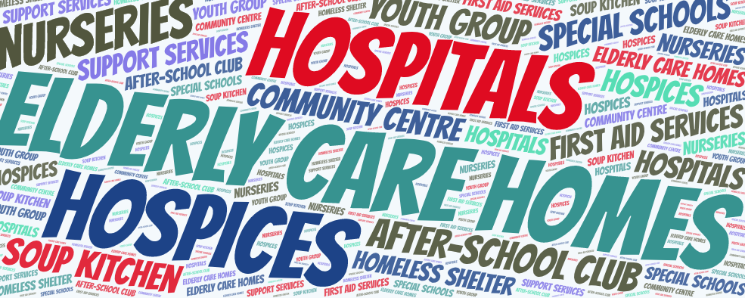
Work experience
Caring or service role with people particularly those who are ill, disabled or disadvantaged.
Medical schools want to see how your work experience has given you:
experience of giving care, support or help to other people
  understand the realities of working in a caring profession
the attitudes and behaviours essential to being a doctor
a realistic understanding of medicine
  physical, organisational and emotional demands of a medical career
Notes:
https://www.medschools.ac.uk/media/2331/relevant-experience-for-applying-to-medical-school.pdf

Slide 44
Personal Statement
Applicants must demonstrate suitable evidence of:
Relevant work experience
Insight into a medical career and your suitability, drawn from your work (and voluntary) experience
An understanding of the NHS constitution and core values
A commitment to society: working for the benefit of others, including voluntary work or significant caring roles
Effective written communication skills: a coherent, well-structured personal statement
Notes:
https://www.lancaster.ac.uk/lms/medicine/mbchb-medicine-and-surgery/entry-requirements/#d.en.413432

Slide 45
Multiple mini interview (MMI)
1
Prep
2
3
Prep
Break
Applicants asked to perform a range of different tasks
Assessed against clearly defined criteria
Multiple interviewers / assessors
Prep
Prep
Break
4
Break
8
7
6
5
Notes:
https://www.lancaster.ac.uk/lms/medicine/mbchb-medicine-and-surgery/how-to-apply/

Slide 46

Example MMI Stations
Read and analyse
a PBL scenario
Interact with a member
of the public
Read a short
statement about an
ethical issue in
medicine & discuss
Short interview to
probe your
understanding of
your career choice
Notes:
https://www.lancaster.ac.uk/lms/medicine/mbchb-medicine-and-surgery/how-to-apply/

Slide 47
Fitness to Practice
Probity
Health:
  All disabilities and medical conditions must be disclosed on your application form as they may affect your ability to practise medicine
  Prospective medical students must be immunised for hepatitis B, MMR and tuberculosis.
Criminal Record:
  All medical students must be cleared by the Disclosure and Barring Service (DBS). Criminal convictions, cautions, reprimands and warnings etc must be declared on UCAS form.
Notes:
https://www.lancaster.ac.uk/lms/medicine/mbchb-medicine-and-surgery/how-to-apply/

