Slide 1

1
Notes:
Variation of title slide

Slide 2



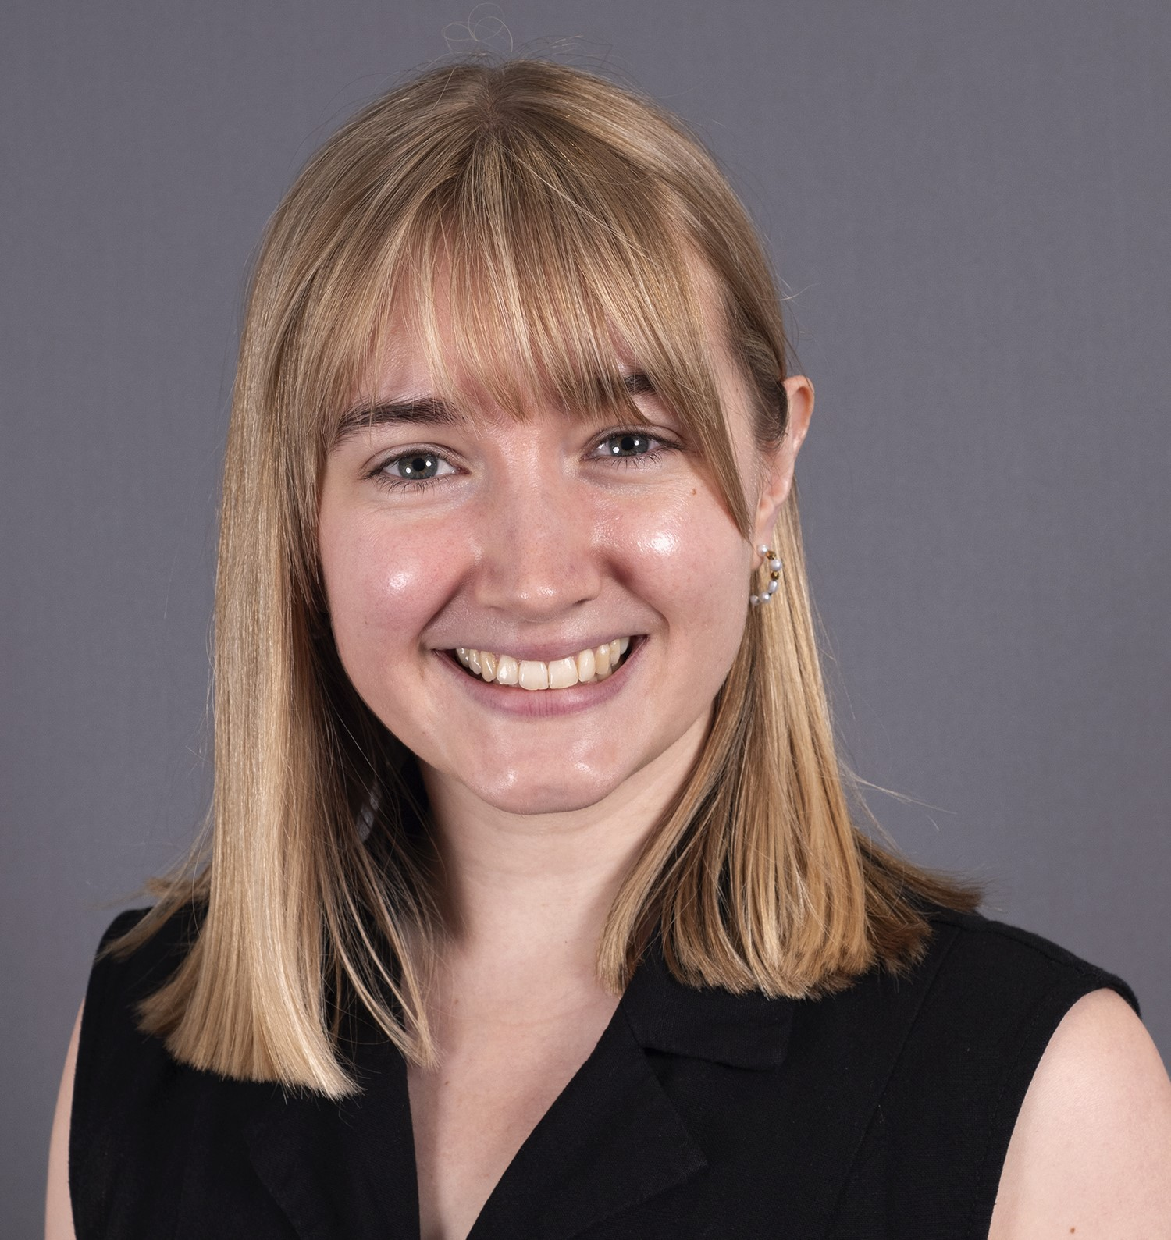



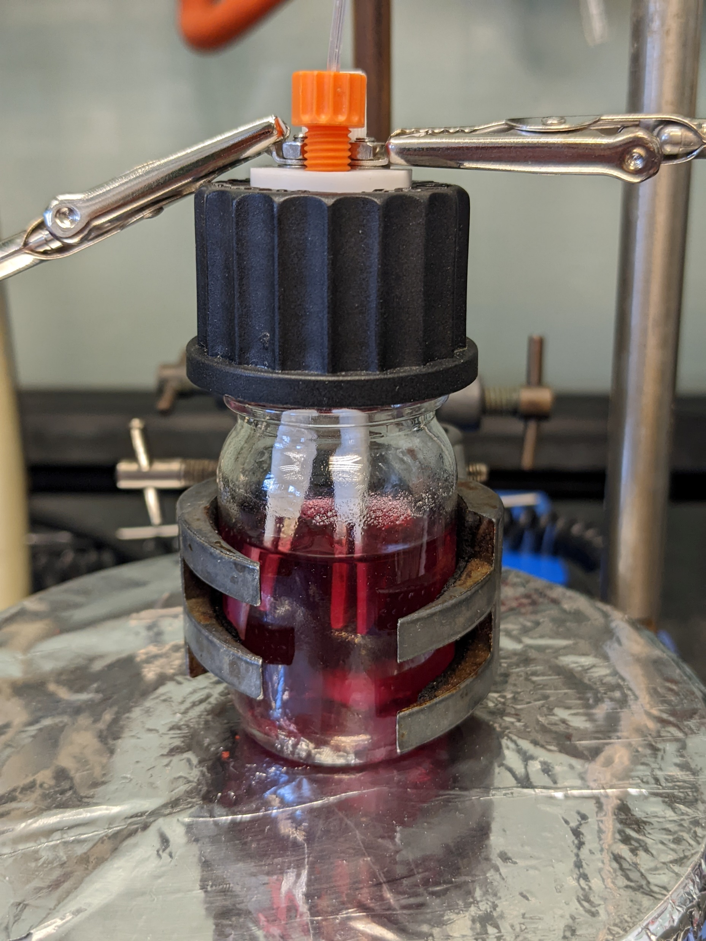
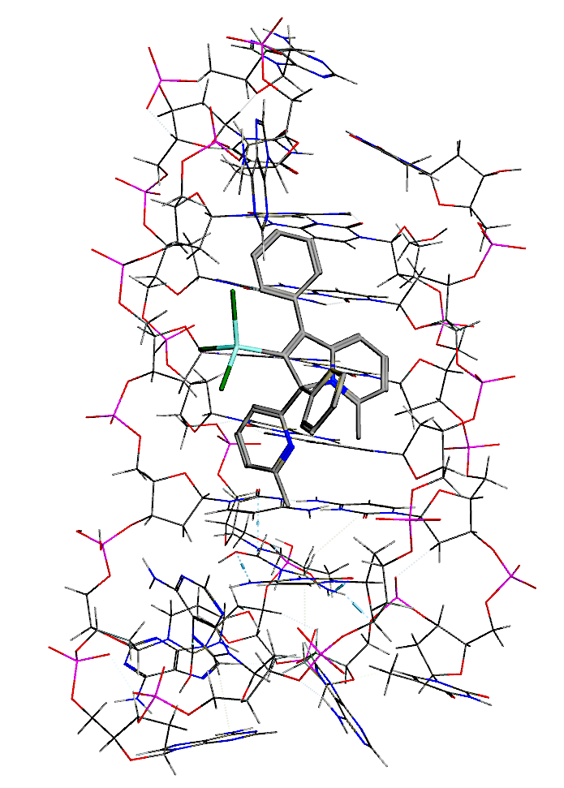
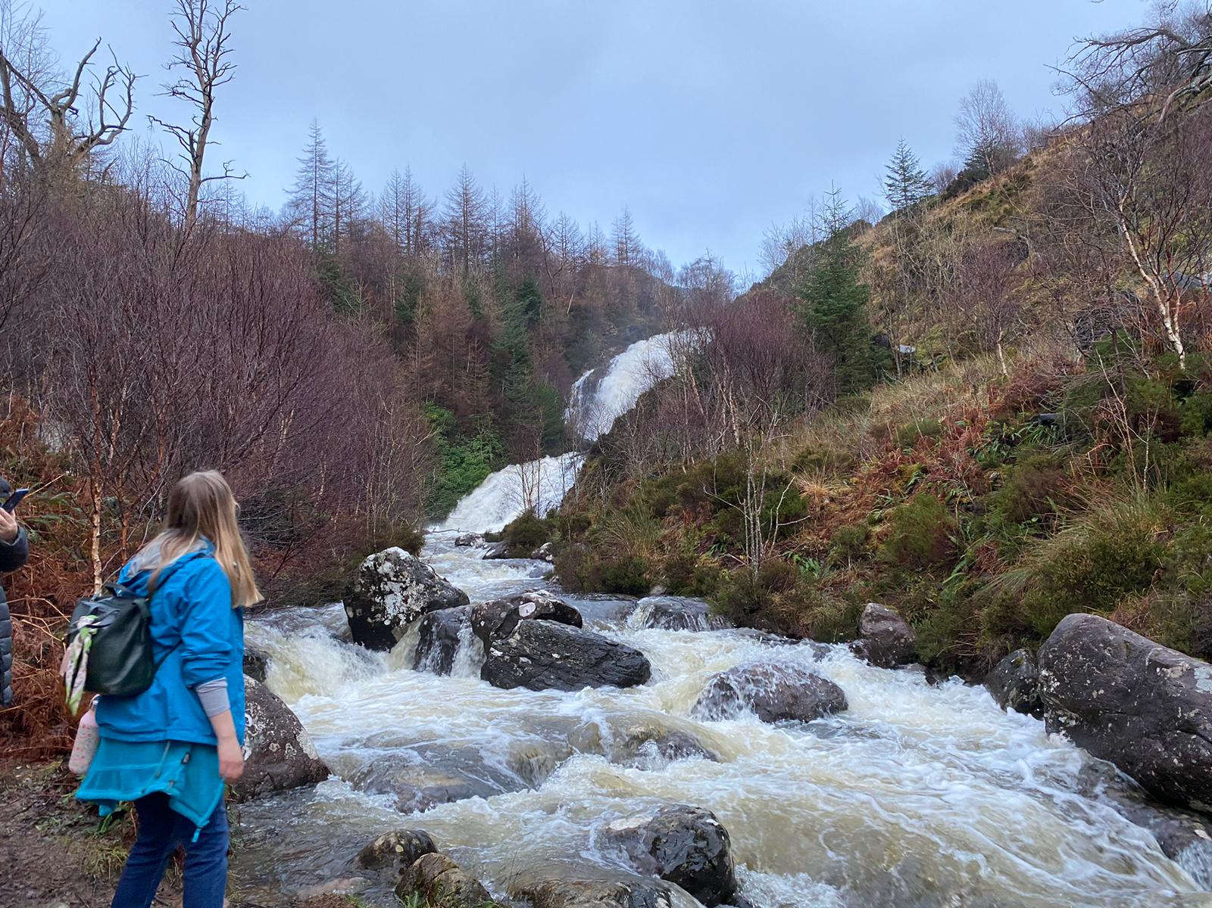
Me and Chemistry – Abi Frith
How did I get here?
PhD in Organometallic Synthesis, Catalysis and Electrosynthesis
Medicinal Chemistry BSc
Chemical Biology and Drug Design MSc
Research Associate
2018
2024
2014
2017
2023
Senior Research Associate
Dr Abi Frith
My research areas:
Organometallic Catalysis
Metal Carbenes
Electrosynthesis

Slide 3


Me and Chemistry – Victoria Walker
How did I get here?
Graduated with 1st class MChem from Uni of Sheffield
Started at CK Group as Trainee Recruitment Consultant
Won the REC’s Consultant of the Year award
Became Manager of the science and engineering teams
2013
2023
2009
2010
Passed probation early
2016
Promoted to Associate Director responsible for training and BD
Victoria Walker
My key areas of expertise:
Recruitment within the chemical manufacturing and materials manufacturing sectors e.g. polymers, coatings, etc.
More strategic responsibilities such as business development activities and relationship building, as well as internal training
Providing advice to job seekers and employers regarding their careers and recruitment processes
Recruitment
Strategy
Advice

Slide 4
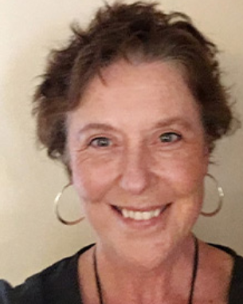


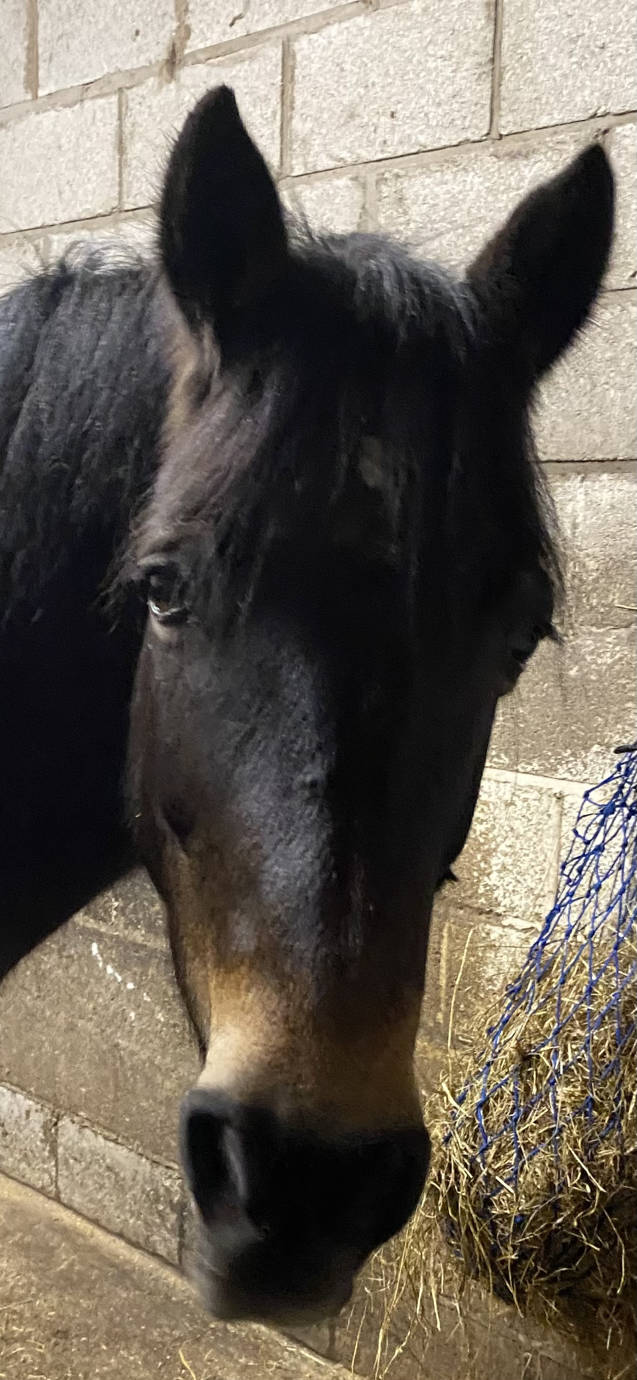

Me and Chemistry
How did I get here?
Chemistry
Safety Officer and Building Superintendent
FST
Technical Director
0.5FTE 4 year secondment
LEC
Lab Manager Soils and Ecosystems Ecology
LEC
Lab Safety Officer
Chemistry Research Technician
LEC Research Technician
1999
2000
2008
2013
2014
2021
Helen Quirk
Current Areas of Focus
Building and Infrastructure Management
Technical Staff Development and Management
Harvey
Safety

Slide 5
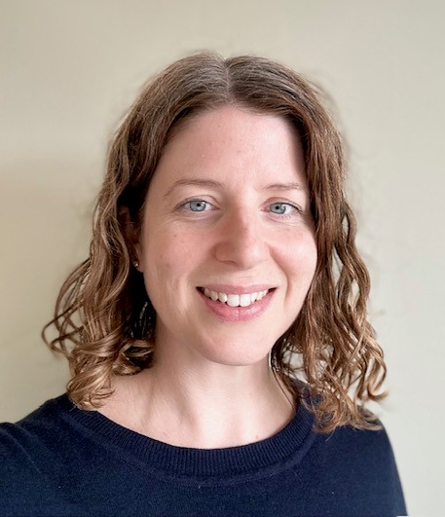




Me and Chemistry – Michelle Eccles
My key career themes:
Nuclear waste management and nuclear operations
Education and skills
Management & leadership
Continuous improvement
Research & Development
Michelle Eccles
How did I get here?
Waste & Residue Processing Capability Manager at UKNNL
Completed Chemistry MChem
Started Teach First graduate scheme
Joined UK National Nuclear Laboratory as Research Technologist
Head of Technical Skills at UKNNL
2019
2023
2006
2006
2012
2018
Qualified Teacher
Joined LU as Head of Operations, Faculty of Science and Technology
Chartered Chemist

Slide 6


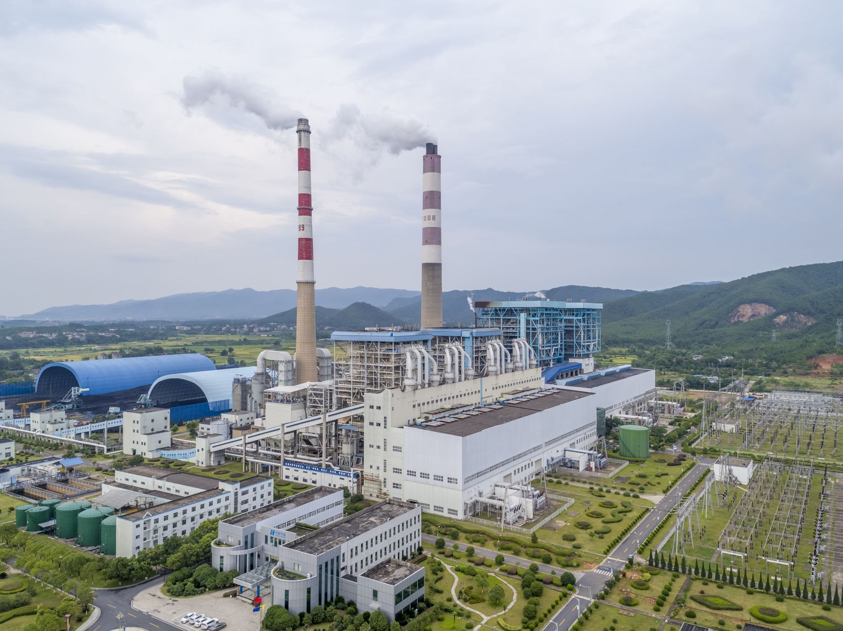
Me and Chemistry – Debbie Coombs
How did I get here?
Chemist Apprenticeship
BSc (HONS) Chemistry
Technical Sales, IMCD & BASF
European Key Account Manager, Borchers-Milliken
2010
2022
1998
2003
Development Chemist, BASF
2020
Senior Leader Apprenticeship - completing MBA
Debbie Coombs
My key areas
d
Coatings Chemistry
Formulation – stability, processability,
long-term performance, problem solving
Commercial sales,
unique sales propositions, relationship management, negotiation, international experience
Management, Market Development, Strategy
Technical Role
Sales Role
→ Direction of travel

Slide 7

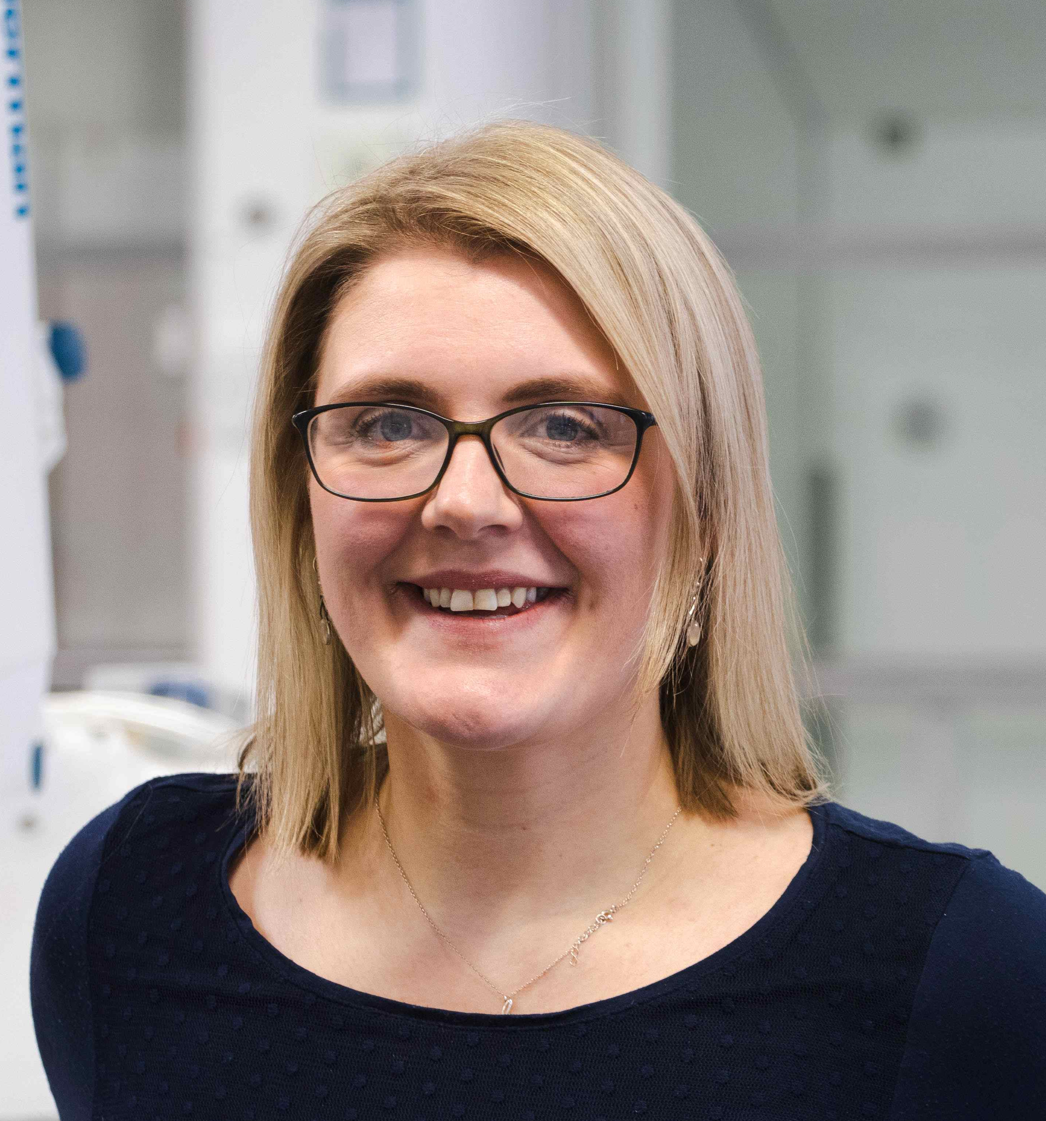






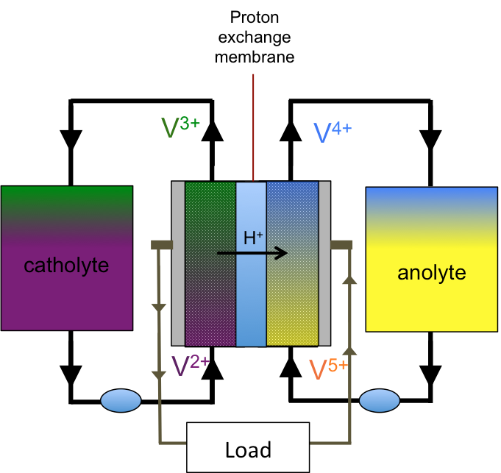

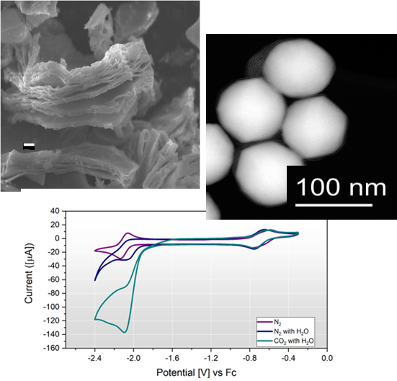
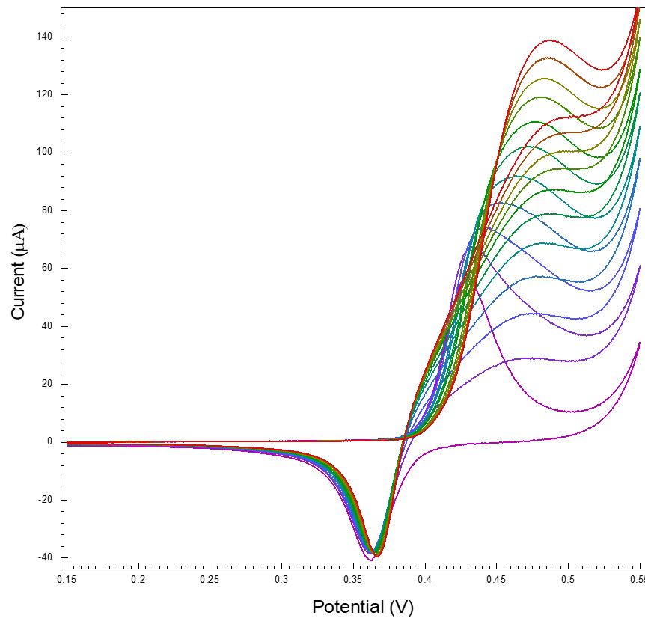
Me and Chemistry – Kathryn Toghill
How did I get here?
Postdoc in EPFL, Switzerland
Started MChem at Swansea University
Started PhD in Electrochemistry Oxford University
Full Professor
Year abroad in UWaterloo, Canada
2007
2011
2014
2003
2005
2018
2022
Kathryn Toghill
Got my first publication!
Postdoc in Oxford
Started as a Lecturer at Lancaster University
My research areas:
Flow Batteries/Energy Storage
Electrocatalysis
Sensors

Slide 8
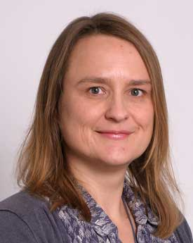



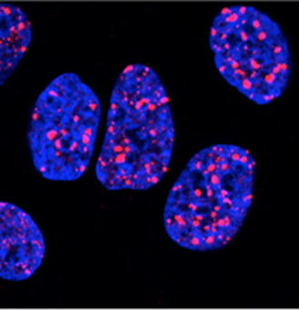
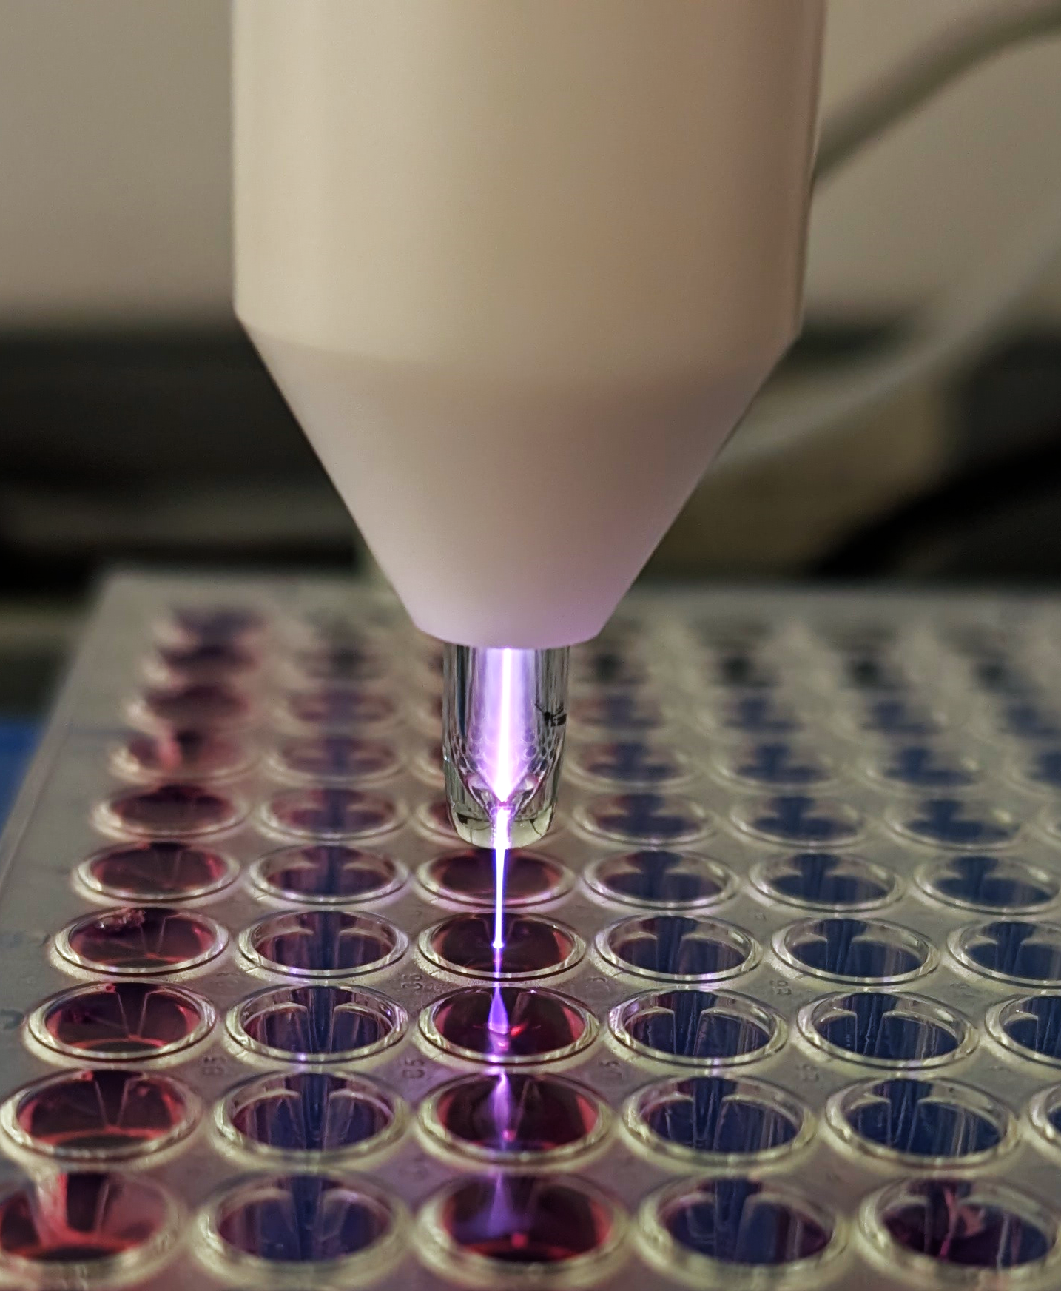
Me and Chemistry – Sarah Allinson
How did I get here?
Second postdoc - MRC Harwell – mechanisms of mammalian DNA repair (Prof Grigory Dianov)
Edinburgh Uni BSc (Hons) Chemistry
Southampton
Uni PhD
Chemistry
(Prof Tom Brown)
Lecturer in Biomedical and Life Sciences (LU)
2001
2009
1994
1998
First postdoc - Southampton
Uni - discipline switch – protein biochemistry (Prof Keith Fox)
2004
Sarah Allinson
North West Cancer Research fellowship @ LU
My key areas of research:
DNA repair
Cancer biology:
DNA damage
Novel cancer treatments

Slide 9
IUPAC Resources
https://gender-gap-in-science.org/
https://www.acs.org/about/diversity/inclusivity-style-guide/diversity-and-inclusion-in-images.html#how-to-choose-image
https://iupac.org/what-we-do/top-ten/
https://www.nobelprize.org/prizes/chemistry/2020/doudna/167713-jennifer-doudna-interview-february-2021/
https://iupac.org/awardees-of-the-iupac-2025-distinguished-women-in-chemistry-or-chemical-engineering/
Past IUPAC Event articles
https://www.degruyter.com/document/doi/10.1515/ci-2024-0302/html
IUPAC periodic table challenge activity:
https://iupac.org/periodic-table-challenge/
https://www.unesco.org/en/days/women-girls-science

Slide 10
Career Pages and Articles
https://www.chemistryworld.com/features/the-health-of-chemistry-across-the-pipeline/4020208.article
https://luminate.prospects.ac.uk/what-do-graduates-do
https://www.rsc.org/careers/whatchemistsearn/
https://edu.rsc.org/future-in-chemistry/career-options/job-profiles/careers-in-chemistry-a-to-z
https://www.rsc.org/news-events/articles/2025/01-january/future-workforce-educational-pathways-report-release/
https://www.timeshighereducation.com/news/universities-do-little-help-phds-who-want-leave-academia#:~:text=More%20than%20half%20of%20PhD,to%20help%20create%20new%20professors
In conversation with Hind Al-Abadleh - Unlocking Environmental Sustainability with Chemistry" - in memoriam
https://www.youtube.com/watch?v=nUzGxGZ6sGw

Slide 11
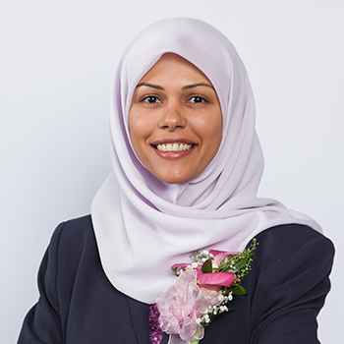
In Memory of Professor Hind A. Al-Abadleh
The Global Chemistry Community mourns the passing of Professor Hind Al-Abadleh on January 10, 2025. A leader in environmental physical chemistry, she tackled critical issues in air quality, atmospheric aerosol chemistry, and geochemistry, earning numerous accolades, including Laurier’s 2023 Hoffman-Little Award and the 2021 University Research Professor Award. Beyond her research, Dr. Al-Abadleh was a dedicated advocate for equity, diversity, and inclusion within the Canadian chemistry community. She was an inaugural member of the CSC’s Working Group for Inclusion, Diversity, and Equity (WIDE), contributed to Making Chemistry Inclusive, and played a key role in advancing equity initiatives. Her passion, data-driven approach, and leadership left a lasting impact on both science and the academic community.

Slide 12
The following slides are related to Chemistry Internships

Slide 13

Internships – get involved!
Spring 2025
Pam Pickles, Student Engagement Manager, Faculty of Science and Technology
Notes:
LANCASTER UNIVERSITY POWERPOINT TEMPLATES
These PowerPoint templates are for use by all University staff. Please see below for further information regarding the use of these templates. Should you have any further queries, please contact the marketing team via webmaster@lancaster.ac.uk
Template slide 3: Insert a new slide
If you need to insert a new slide, from the ‘home’ toolbar, click on ‘new slide’ and select from the templates the style you require from the dropdown box.
Template slide 4: Typing new text and copying text from another document
New text should be typed over the text in the appropriate template. Copy and pasting text from another document will result in changing the style of the typography and layout. This is unavoidable as it is part of the Microsoft software. We appreciate that in sometimes you will need to copy text from another document into this template. Once you have pasted the existing text into the template, you will need to change the formatting so that they typefaces, sizes, colour, line spacing and alignment are consistent with the rest of the template.
Template slide 5: Inserting images
There are three choices of templates with images already inserted. Please use the template with the relevant image size and positioning. To insert an image, please go to ‘insert’ then ‘picture’ and find your image, highlight it and ‘insert’. Resize the image and position as per the example template.
Template slide 6: Text boxes
If a text box is deleted, either insert a new slide (using the appropriate template) or go to another slide and copy a text box. To select a text box for copying, please click on the outer edge of the text box so that the line goes solid (not dashed). Right click your mouse and select ‘copy’, then go back and ‘paste’ it into the slide where the text box is missing which should paste into the correct position on the slide.
Template slide 7: Other information
Typefaces, sizes and colours
All copy is Calibri.
Slide title copy throughout:
Size: 36 point
Colour Lancaster University red: (RGB) R: 181 G: 18 B: 27 (recent colours on PowerPoint)
Small copy on first and last slide:
Size: 16 point
Colour grey: (RGB) R: 102 G: 102 B: 102 (recent colours on PowerPoint)
Sub-headings:
Size: 24 point – italics
Colour grey: (RGB) R: 102 G: 102 B: 102 (recent colours on PowerPoint)
Bullets copy and body copy:
Size: 24 point (see below for a further option)
Colour grey: (RGB) R: 102 G: 102 B: 102 (recent colours on PowerPoint)
It isn’t advisable to have too much text on a slide, however on rare occasions it may be necessary, therefore there is a slide using 20 point bullet pointed text.
Line spacing and alignment
Single line spacing (apart from the main headings which is ‘exactly 35 point’)
All text is aligned left
Slide title options
There are two options for titles on the slides – one line or two lines for longer titles. Ideally, the one line title should be used, however on rare occasions a two line title maybe needed.

Slide 14
Some stats to start off with…..
Lancaster Chemistry graduates 15 months after graduation in 2021:
Working and studying: 50%
Further study 41.7%
Unemployed 8.3%
Top three sectors:
Manufacturing 44.4%
Professional, Scientific and Technical 18.5%
Education 11.1%

Slide 15
Graduate level jobs:
Research & Development
Chemists
Finance & Investment
Business Professionals
Median salary: £30,658
A great blog to highlight some options:
https://www.licasci.com/blog/view/145/index0/You-Don-T-Have-To-Wear-A-White-Coat-To-Work-In-Science

Slide 16

But – what if you don’t know what you want to do?

Slide 17

Internships can really help!
University Employability Strategy
We will produce graduates whose skills and knowledge are sought after in national and international job markets:
By working increasingly closely with employers and alumni to inform our activities and by providing opportunities for students to engage in placements, work experience and volunteering

Slide 18


FST Internship Programme
A programme of opportunities
for FST students
Paid opportunities, with all
students being paid the
National Living Wage
Internships which vary in
length to include 3 month
summer vacation
Part-time and full-time
opportunities

Slide 19
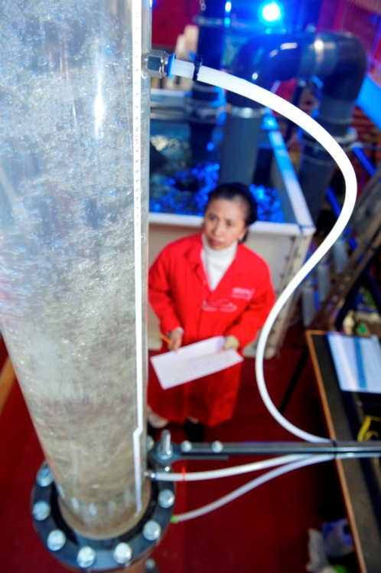
You can offer:
Research and problem-solving skills
Experience of project planning and time
management
The ability to gather, analyse and
communicate complex data
Flexibility, gained from working in a
variety of environments
Numeracy and IT skills
Report writing and communication skills

Slide 20
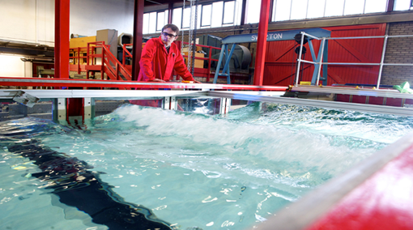
You can gain:
The ability to apply your academic knowledge to the workplace
A recognition of both the scope and the limitation of the application of academic knowledge to the workplace
The opportunity to work in a business on projects directly related to your subject knowledge

Slide 21
Our research says:
48% of interns were offered further employment either with their host company or another organisation as a result of undertaking their internship
100% of interns would recommend undertaking an internship to other students
100% of businesses would recommend the internship programme to others
100% of businesses are considering taking on another intern

Slide 22
Roles for Chemistry students
Victrex – Manufacturer of PEEK Polymers, based in the Northwest. Hosts a Chemistry intern on a regular basis
Thermofisher – Provides scientific services across the science sector – based locally
Yordas – Campus-based scientific regulatory consultancy. Has interns every year, predominantly from a Chemistry background. Two-thirds of the company is made up of Lancaster graduates

Slide 23
Virtual/remote internships
Remote internships are not new to Science and Technology: Many previous roles have been research-based and can be conducted anywhere
According to The Guardian (1st October 2020) 24% of the UK working population is now working exclusively from home
Large corporates have reacted swiftly to this: Check out ‘Rate my Placement’ for virtual experience opportunities
For volunteering opportunities, telephone befriending has proved to be key to supporting vulnerable people since the COVID pandemic
Virtual internships are very accessible as they can be undertaken anywhere and by anyone

Slide 24
Interested?
Search and apply for vacancies: Internship Programme Vacancies
Alternatively email our team on scitech.futures@lancaster.ac.uk
Follow us on Facebook:
www.facebook.com/LancasterUniversitySciTechFutures/
Or find us on Instagram lu_scitechcareers
Website: www.lancs.ac.uk/sci-tech/internships

Slide 25
Any Questions?
Spring 2025
Pam Pickles, Student Employability Manager, Faculty of Science and Technology

