Slide 1
续论及其在国际中文教育中的应用
Continuation Theory and Its Application in Chinese Language Teaching
杨梅 YANG Mei
华南理工大学 South China University of Technology
兰卡斯特大学孔子学院 Lancaster University Confucius Institute
April 23, 2024

Slide 2
Contents
Continuation (续 xu): what and why
Continuation theory, or the xu-argument (续论)
The application of continuation theory in language instruction
Questions and discussion

Slide 3
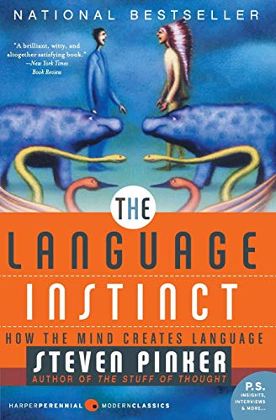
How does a child learn his/her first language?
How did you learn a second language?
The UG-based explanation
The usage-based explanation
input, output, interaction, ……

Slide 4
Language is learned through interaction.
(Vygotsky 1962)
Interaction constitutes the essential means of language use and acquisition.
(Atkinson et al. 2007)
It is now commonly accepted within the SLA literature that there is a robust connection between interaction and learning.
(Gass & Mackey 2015)

Slide 5
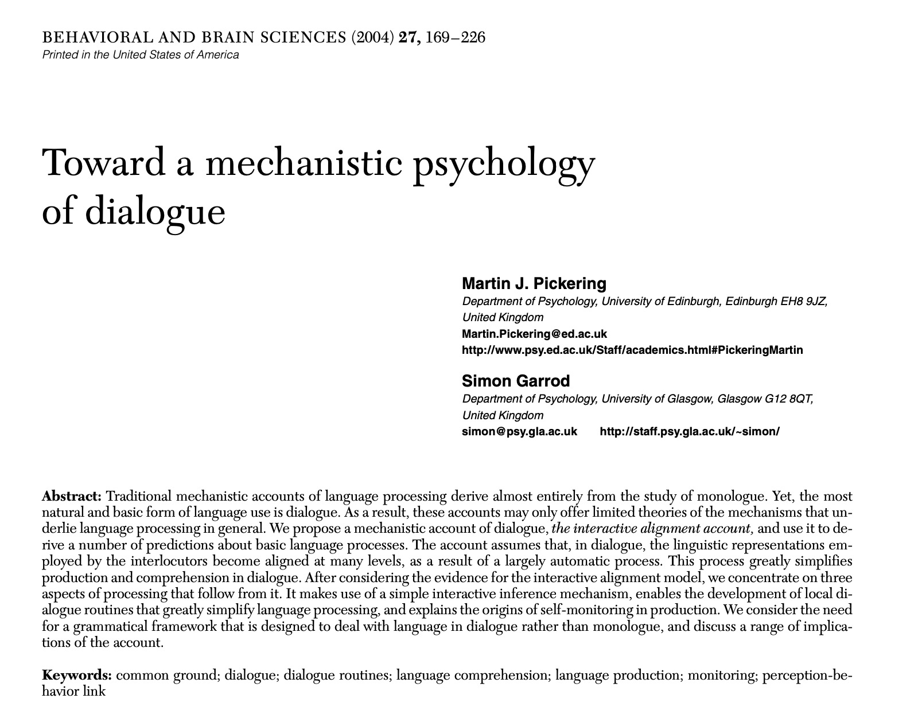
Interactive alignment model (Pickering & Garrod 2004)
Dialogue →
“the most natural and basic form of language use”
(Pickering & Garrod, 2004)

Slide 6
续
continuation

Slide 7
续，“连也”。《说文》
续，“继也”。《尔雅》
续， 添加。
续，传递。“教顺施续，而知能流通”《淮南子》
续，后同于前，重复。“寡君之绍续昆裔”《国语》
link
complete
add
transmit
repeat

Slide 8
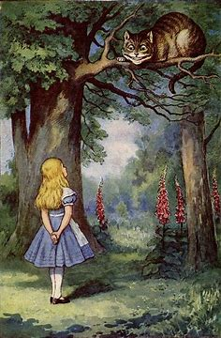
link
extend
“Would you tell me, please, which way I ought to go from here?”
“That depends a good deal on where you want to get to,” said the Cat.
“I don’t much care where—” said Alice.
“Then it doesn’t matter which way you go,” said the Cat.
“—so long as I get somewhere,” Alice added as an explanation.
“Oh, you’re sure to do that,” said the Cat, “if you only walk long enough.”
complete
repeat
create

Slide 9
Continuation (xu) → CEC Wang (2016)
补全 Completing → discourse completion
拓展 Extending → content extension
创造 Creating → topic creation

Slide 10
Continuation theory,
or the xu-argument
续论

Slide 11
The xu-argument (王初明 Chuming Wang, 2016; 2017)
1、语言通过续学会。
Language learning is driven by interaction originating from xu/CEC(completion, extension and creation).
2、语言学习的高效率可以通过续实现。
High efficiency in language learning can be achieved via xu/CEC.

Slide 12
Interactive Alignment Model (Pickering & Garrod 2004)
the act of convergence on linguistic behavior in interaction achieved by interlocutors adopting and reusing each other’s expressions, structures and pronunciation patterns
(Pickering & Garrod, 2004, 2021)
Linguistic alignment can facilitate second language (L2) learning and lead to long-term learning benefits.
(Kim, Jung, & Skalicky, 2019)

Slide 13
Interactive alignment → the cognitive basis of continuation theory
续 xu
互动 interaction
协同 alignment
学习 learning
续 xu
（王初明 2022)

Slide 14
Learn through interaction originated from and driven by continuation (xu)
交际意图
内生表达动力
语境融入
互动协同
语言理解与产出结合
Willingness to communicate
Meaning potential (Halliday 1973)
Contextualized
Interaction alignment
Coupling of language comprehension and production

Slide 15
Creative imitation → the core of learning by continuation
Language imitation reuse; repetition
语言要模仿
Content creation link; add; complete; transmit; extend
内容要创造
(王初明 2016, 2022)

Slide 16
Theoretical development:
Wang, C. M. & Wang, M. 2015. Effect of alignment on L2 written production[J]. Applied Linguistics, 36(5): 503-526.
Zhang, X. Y. 2017. Effects of receptive-productive integration tasks and prior knowledge of component words on L2 collocation development[J]. System, 66: 156-167.
Zhang, X. P., Lu, X. F. & Li, W. W. 2021. Beyond differences: Assessing effects of shared linguistic features on L2 writing quality of two genres[J]. Applied Linguistics: 1-29.

Slide 17
Pedagogical studies:
Zhang, X. Y. 2017. Reading-writing integrated tasks, comprehensive corrective feedback, and EFL writing development [J]. Language Teaching Research, 21(2): 217-240.
Peng, J. F., Wang, C. M., & Lu, X. F. 2018. Effect of the linguistic complexity of the input text on alignment, writing fluency, and writing accuracy in the continuation task[J]. Language Teaching Research, 24(3): 364-381.
Zhou, X. & Wang, C. M. 2021. Effects of interactive alignment on L2 vocabulary learning by Chinese EFL learners[J]. Language Teaching Research: 1-31.
Xie, Y., & Zhu, D. 2023. Effects of participatory structure of pre-task planning on EFL learners’ linguistic performance and alignment in the continuation writing task[J]. System, 114, 1-11.

Slide 18
Language testing:
Ye, W. & Ren, W. 2019. Source use in the story continuation writing task [J]. Assessing Writing, 39(4): 39-49.
Shi, B., Huang, L., & Lu, X. 2020. Effect of prompt type on test-takers’ writing performance and writing strategy use in the continuation task[J]. Language Testing, 37(02), 1-28.

Slide 19
基于续论的语言教学法
The xu-based instruction (XBI)
基于续论的国际中文教学
The xu-based CFL/CSL instruction (XBCI)

Slide 20
Continuation theory and CSL/CFL
洪炜, 申昭贞. 2021. 读后续听任务在汉语二语词汇学习中的有效性研究. 汉语学习
王启. 2019. 读后续写协同效应对汉语二语学习的影响. 外语与外语教学
王启. 2016. 汉语二语读后续写的协同效应. 现代外语
徐富平, 王初明. 2020. 复诊续写任务促学医学汉语词汇的效应. 解放军外国语学院学报
杨梅，严晓朦. 2023. 汉语关系从句的二语理解与产出——续论学习观视角.汉语学习
周一书. 2021. 续作训练提高留学生汉语产出能力的行动研究. 华文教学与研究
Wang & Hong, 2021, An alignment-based approach to L2 learning of Chinese numeral classifiers[J]. Chinese Journal of Applied Linguistics, 44(03), 335-350.
Zhang, 2022, Effect of interaction and alignment of continuation task in Chinese as a second language writing[J]. Journal of Language, Identity and Education, 1-13.

Slide 21
The application of continuation theory
in language instruction

Slide 22
High efficiency in language learning can be achieved via xu/CEC. → Learning by continuation
But how?
e.g. the xu-based task design
To achieve high efficiency in language teaching and learning, tasks can be designed to encourage learners to interact more with the linguistic input provided in conversations, discourses, or texts.

Slide 23
Learn through interaction originated from and driven by continuation (xu)
交际意图
内生表达动力
语境融入
互动协同
语言理解与产出结合
Willingness to communicate
Meaning potential (Halliday 1973)
Contextualized
Interaction alignment
Coupling of language comprehension and production

Slide 24
Types of interactions
Interpersonal interaction
Intrapersonal interaction
Human - environment interaction
human-tool interaction
human-AI interaction
……

Slide 25
理解comprehension 续xu 产出production
说 speak
听 listen
写 write
读 read
译 translate
output
input

Slide 26
Two exemplary studies
汉语二语会话中的不完整语段研究
Incomplete Utterances as Continuation Strategies in Mandarin Conversation
（Yang & Tong, to appear)
读后续写协同效应对汉语二语学习的影响
Effect of the Continuation Task on Learning Chinese as a Second Language
（Wang, 2019)

Slide 27
Incomplete Utterances as Continuation Strategies in Mandarin Conversation
a conversation analytic case study
to investigate how incomplete utterances (IUs) work as continuation (or xu in Chinese) strategies to develop, maintain and promote a mandarin conversation.

Slide 28
Research questions
How do IUs help mandarin interlocutors to achieve mutual understanding through continuation?
How do L1 speaker use IUs to help L2 interlocutor develop his L2 Chinese interactional competence through continuation?

Slide 29
Participants
Alex: a 26-year-old male graduate student from Russia, had learned both English and Chinese for over 15 years, and had worked in China as an English teacher for five years.
Xie: a college teacher who has obtained Putonghua Certificate of level 2, grade A and Teacher Qualification Certificate.

Slide 30
Methods
Data collection:
natural conversation audio- and video-recorded
Stimulated recall
Data transcription:
1) the transcription of verbal aspects→ the system devised by Gail Jefferson
2) the transcription of non-verbal aspects → a system that integrates both textual description and photographic images

Slide 31
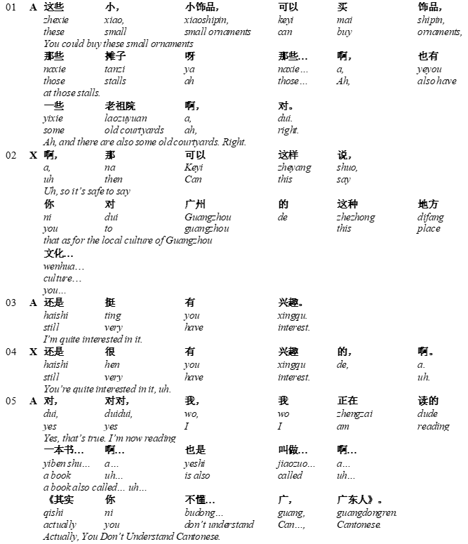

Slide 32
Results: IU as continuation strategies
IUs can
1) provide opportunities for the use of CEC strategies in the conversation;
2) generate the learner’s internal motivation to talk in L2;
3) make authentic L2 input accessible to the learner.
The use of IUs in a dialogue is itself a continuation strategy.

Slide 33
The reading–writing integrated continuation task 读后续写 (Wang 2016; 2019; 2023)
Learners are provided with a text that consists of a story with its ending removed and required to read the text of the incomplete story and complete it through writing in the most coherent and logical way possible.
Learners are pushed to interact with the input, thus to connect what is currently being written with what has gone before.
This task is discourse-oriented, content-based and meaning-driven, bringing language learning to bear on creation of ideas or dynamic contents in conformity with the xu-argument.

Slide 34
阅读下面短文，根据所给情节进行续写，使之构成一个完整的故事。
A funny thing happened to Arthur when he was on the way to work one day. As he walked along Park Avenue near the First National Bank, he heard the sound of someone trying to start a car. He tried again and again but couldn’t get the car moving. Arthur turned and looked inside at the face of a young man who looked worried. Arthur stopped and asked, “It looks like you’ve got a problem,” Arthur said.
“I’m afraid so. I’m in a big hurry and I can’t start my car.”
“Is there something I can do to help?” Arthur asked. The young man looked at the two suitcases in the back seat and then said, “Thanks. If you’re sure it wouldn’t be too much trouble, you could help me get these suitcases into a taxi.”
“No trouble at all. I’d be glad to help.”
The young man got out and took one of the suitcases from the back seat. After placing it on the ground, he turned to get the other one. Just as Arthur picked up the first suitcase and started walking, he heard the long loud noise of an alarm.
It was from the bank. There had been a robbery (抢劫)!
Park Avenue had been quiet a moment before. Now the air was filled with the sound of the alarm and the shouts of people running from all directions. Cars stopped and the passengers joined the crowd in front of the bank. People asked each other, “What happened?” But everyone had a different answer.
Arthur, still carrying the suitcase, turned to look at the bank and walked right into the young woman in front of him.
She looked at the suitcase and then at him. Arthur was surprised. “Why is she looking at me like that?” He thought. “The suitcase! She thinks I’m the bank thief!”
Arthur looked around at the crowd of people. He became frightened, and without another thought, he started to run.

Slide 35
注意：
1. 所续写短文的词数应为150左右；
2. 应使用5个以上短文中标有下划线的关键词语；
3. 续写部分分为两段，每段的开头语已为你写好；
4. 续写完成后，请用下划线标出你所使用的关键词语。
Paragraph 1:
As he was running, Arthur heard the young man shouting behind, “Stop, stop!”
__________________________________________________________________________
Paragraph 2:
The taxi stopped in front of the Police Station and Arthur...
___________________________________________________________________________

Slide 36
乌鸦喝水
一只乌鸦口渴了，到处找水喝。 乌鸦看见一个瓶子。瓶子里有水，可是瓶子很高，瓶口很小，里边的水又少，它喝不着水。怎么办呢？ 乌鸦看见旁边有许多小石子，它想了一想，有办法了！ 乌鸦把小石子一个一个地衔起来，放到瓶子里。瓶子里的水慢慢升高，乌鸦就喝着水了。

Slide 37
乌鸦喝水
一只乌鸦口渴了，到处找水喝。 乌鸦看见一个瓶子。瓶子里有水，可是瓶子很高，瓶口很小，里边的水又少，它喝不着水。怎么办呢？ 乌鸦看见……

Slide 38
请看下面的图片，并把故事讲完。
一只乌鸦口渴了，到处找水喝。
乌鸦看见一个瓶子。瓶子里有水，可是瓶子很高，瓶口很小，里边的水又少，它喝不着水。怎么办呢？
乌鸦看见……

Slide 39
Effect of the Continuation Task on Learning Chinese as a Second Language （Wang 2019）
The alignment effect of continuation task remains to be verified in the learning of other languages．
Chinese language has a unique written system with its words indistinct from characters in print. This written system may cause reading difficulty for L2-Chinese learners and weaken the alignment effect in using the continuation task

Slide 40
Effect of the Continuation Task on Learning Chinese as a Second Language
发展中国家用电器
发展 中国 家用 电器
发展 中 国家 用 电器
发展中 国家 用电器

Slide 41
To examine the effect of two print types on the performance of the continuation task with one type exhibiting word-based print and the other presenting the normal character-based print．
Subjects of the study were 58 intermediate L2-Chinese learners

Slide 42
Research questions
分词连写能否增强汉语二语读后续写的协同效应，从而增加阅读材料中词语、词块和特殊句法结构在续写中的使用?
Can word-based print enhance the alignment effect of L2 Chinese L2 continuation writing, thereby increasing the use of vocabulary, word chunks, and specialized syntactic structures from reading materials in writing?
分词连写能否借助读后续写所产生的协同效应减少二语偏误?
Can word-based print leverage the alignment effect generated by L2 continuation writing to reduce language errors?

Slide 43
Materials
一家有名的大公司在报纸上刊登一则招聘广告，要招一名接待员。应聘当天，看到广告前来应聘的有五十多人，他们不是拿着厚厚的简历表，就是带着各种各样的证书，甚至还有人带着公司总经理的朋友的介绍信。
一 家 有名 的 大 公司 在 报纸 上 刊登 一 则 招聘 广告 , 要 招 一 名 接待员 。 应聘 当天 , 看到 广告 前来 应聘 的 有 五十多 人 , 他们 不是 拿着 厚厚 的 简历 表 , 就是 带着 各种各样 的 证书 , 甚至 还 有人 带着 公司 总经理 的 朋友 的 介绍信 。

Slide 45
Results show that
although both types of print produced an alignment effect, the effect associated with the word-based print was stronger
alignment effect occurred in such linguistic structures as word， lexical chunks and syntactic structures, and its strength varied with different structures
the word-based print was conducive to enhancing reading comprehension and reducing errors in the continuations although errors persisted in a small number of structures
These findings testified the alignment effect of the continuation task in L2-Chinese and pointed to an easy and effective way to the enhancement of this effect in L2-Chinese learning．

Slide 46
请看下面的图片，并把故事讲完。
一只乌鸦口渴了，到处找水喝。
乌鸦看见一个瓶子。瓶子里有水，可是瓶子很高，瓶口很小，里边的水又少，它喝不着水。怎么办呢？
乌鸦看见……

Slide 47
请看下面的图片，并把故事讲完。
一只 乌鸦 口渴 了，到处 找水 喝。
乌鸦 看见 一个 瓶子。瓶子 里 有水，可是 瓶子 很高，瓶口 很小，里边 的 水 又 少，它 喝不着 水。怎么 办 呢？
乌鸦 看见……

Slide 48
Questions and discussion

Slide 49
Current practices of XBCI
Theoretical development:
The xu-argument and L2 Chinese acquisition
learning mechanism of L2 Chinese
Pedagogical development:
The design of L2 Chinese tasks and practices
L2 Chinese classroom interaction
L2 Chinese testing
L2 Chinese textbooks

Slide 50
Discussion: How to use continuation theory in
developing L2 Chinese teaching methods
designing L2 Chinese tasks and practices
improving L2 Chinese classroom interaction
reforming L2 Chinese testing
developing L2 Chinese textbooks
revising L2 Chinese course syllabus

Slide 51
LUCI local teacher Emma Massara:
Dialogue-based teaching methods
E：你好。
A：你好。
E：你好吗？
A：我很好。你好吗？
E：我马马虎虎。你喜欢什么颜色?
A：我喜欢蓝色。你喜欢什么颜色?
E：我喜欢紫色。你几岁?
A：我9岁。你几岁？
E：我11岁。你叫什么？
A：我叫Abi。你叫什么？
E：我叫Eloise。再见。
A：再见。

Slide 52
HSK 4 Writing

Slide 53
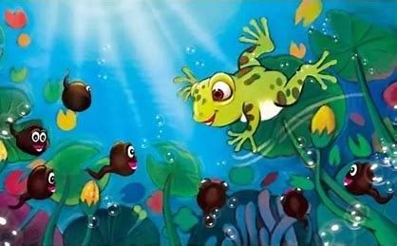
请仔细阅读后，用80字把故事讲完。
要全部使用下面的词语：迎上去、披着、快活
请结合图片完成故事。
小蝌蚪找妈妈 池塘里有一群小蝌蚪，大大的脑袋，黑灰色的身子，甩着长长的尾巴，快活地游来游去。 小蝌蚪游哇游，过了几天，长出了两条后腿。他们看见鲤鱼妈妈在教小鲤鱼捕食，就迎上去，问：“鲤鱼阿姨，我们的妈妈在哪里？”鲤鱼妈妈说：“你们的妈妈四条腿，宽嘴巴。你们到那边去找吧！” 小蝌蚪游哇游，过了几天，长出了两条前腿。他们看见一只乌龟摆动着四条腿在水里游，连忙追上去，叫着：“妈妈，妈妈！”乌龟笑着说：“我不是你们的妈妈。你们的妈妈头顶上有两只大眼睛，披着绿衣裳。你们到那边去找吧！” 小蝌蚪游哇游，过了几天，尾巴变短了。他们看见……

Slide 54
HSK 5 Writing

Slide 55
仔细阅读下面的短文，然后用400字把故事讲完。
小蝌蚪找妈妈 池塘里有一群小蝌蚪，大大的脑袋，黑灰色的身子，甩着长长的尾巴，快活地游来游去。 小蝌蚪游哇游，过了几天，长出了两条后腿。他们看见鲤鱼妈妈在教小鲤鱼捕食，就迎上去，问：“鲤鱼阿姨，我们的妈妈在哪里？”鲤鱼妈妈说：“你们的妈妈四条腿，宽嘴巴。你们到那边去找吧！” 小蝌蚪游哇游，过了几天，长出了两条前腿。他们看见一只乌龟摆动着四条腿在水里游，连忙追上去，叫着：“妈妈，妈妈！”乌龟笑着说：“我不是你们的妈妈。你们的妈妈头顶上有两只大眼睛，披着绿衣裳。你们到那边去找吧！” 小蝌蚪游哇游，过了几天，尾巴变短了。他们看见……

Slide 56
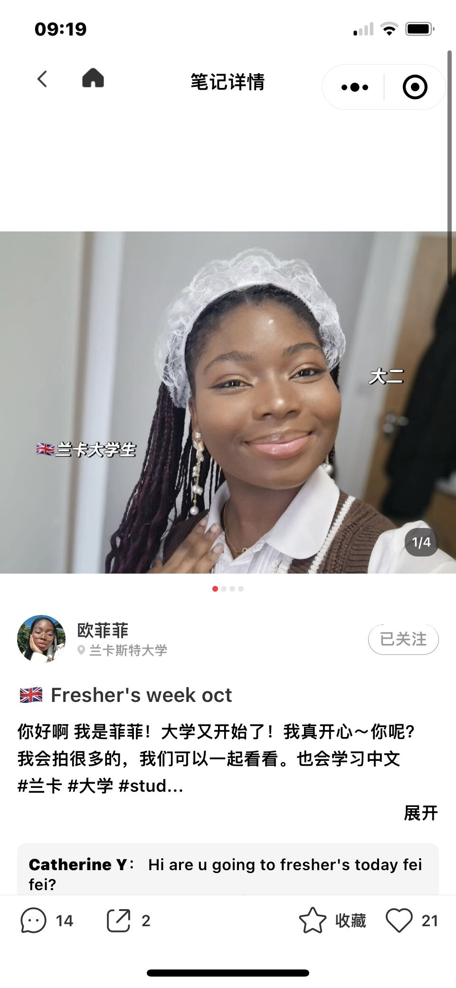
基于续论的汉语学生口语能力训练营
（兰卡斯特大学孔子学院特色训练项目）
欧菲菲

Slide 57
Conclusion
Teaching by showing, learning by doing
Learning by continuation= showing + doing
Continuation theory ---- L2 Chinese instruction practice
The xu-argument opens up a new avenue for L2 Chinese learning and teaching？

Slide 58
References
Anderson, J. 1976. Language, memory, and thought. Halesdale, N. J.: Lawrence Erlbaum.
Halliday, M. 1973. The functional basis of language. In B. Bernstein (ed.). Class, codes and control, vol. II [C]. London: Routledge and Kegan Paul.
Halliday, M. 1975. Learning how to mean: Explorations in the development of language. London: Arnold.
Larsen-Freeman, D. (2003). Teaching language from grammar to grammaring. Boston, MA Thompson-Heinle.
Long, M. 1991. Focus on form: A design feature in language teaching methodology. In K. de Bot, R. Ginsberg &C. Kramtch(eds.).Foreign language research in cross-cultural perspective [C]. Amsterdam: John Benjamins.
Pickering, M. J., & Garrod, S. 2004. Toward a mechanistic psychology of dialogue. Behavioral and Brain Sciences, 27: 169-226.
Vygotsky, L.S. 1962. Thought and language. Cambridge, MA: MIT Press.
Wang, C & Wang, M. 2015.Alignment effect on L2 written production, Applied Linguistics, 36/5:503-526.
Widdowson, H. 1978. Teaching language as communication. Oxford: Oxford University.

Slide 59
THANK YOU

