Slide 1
Environmental policy and integrated delivery: opportunities and barriers
Chris Short
Countryside and Community Research Institute
Jenny Phelps
Gloucestershire Farming and Wildlife Advisory Group

Slide 2
Outline
Developments in Environmental Policy
Attractions of Integrated Delivery
Upper Thames Pilot Catchment
Things we have learned so far
Discussion

Slide 3
Current policy initiatives
Natural Environment WP and Lawton ‘more, better and joined up’.
Localism Bill and big society.
Water Framework Directive: ‘good ecological status’ in water bodies by 2027.
Climate change

Slide 4
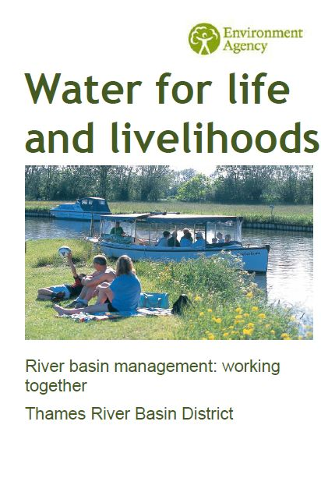
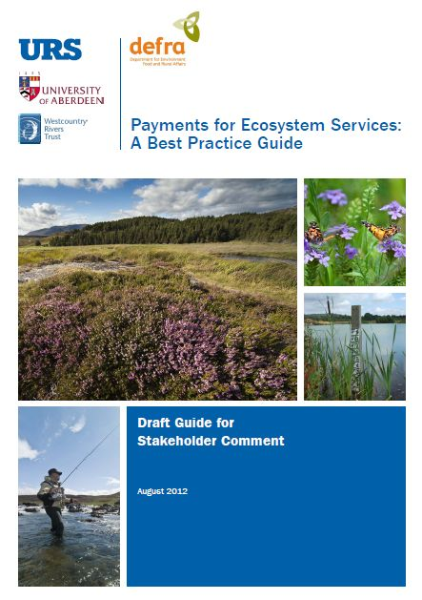
Current policy drivers
Integration integral to policy direction.
NIAs, LNPs, LEPs
WFD is major driver, similar to PSA target for SSSIs
Catchment, landscape-scale approaches and PES have been ‘opened up’ to NGOs

Slide 5
Attractions of integrated delivery
Sharing the burden (State and society)
Localism and Big Society (always been there)
Smaller Government
More from less (‘sum of the parts’ argument)
Reducing duplication and isolated work
Systems (not issue) approach to delivery
Increased awareness
More and wider range of groups/individuals involved

Slide 6
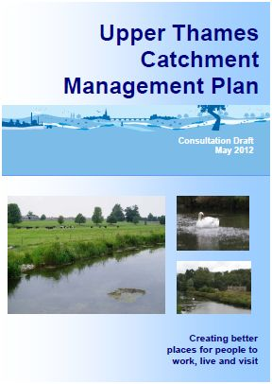
WFD and River Basin Planning
“WFD is designed to improve and integrate the way water bodies are managed throughout Europe” (Defra);
“establishes a strategic framework for managing the water environment.” (Defra)
Focus on river basins, sub-divided into catchments
NGOs to host pilots

Slide 7
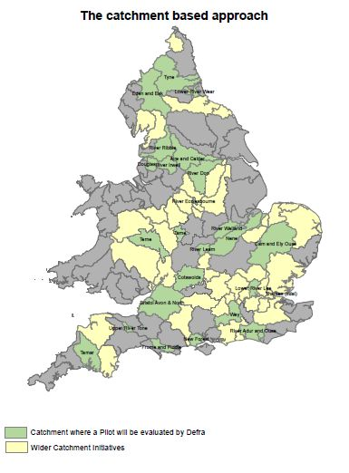
Taking up the WFD invitation
5 river trusts
2 water companies
3 partnerships
2 wildlife trusts
Regional park
National park
FWAG SW & CCRI

Slide 8
Cotswolds Catchment
Predominantly rural in character.
Two AONBs
Cotswolds AONB (North)
North Wessex Downs (south)
Principal towns:
Swindon and Cirencester
Smaller market towns (Lechlade, Fairford) throughout

Slide 9
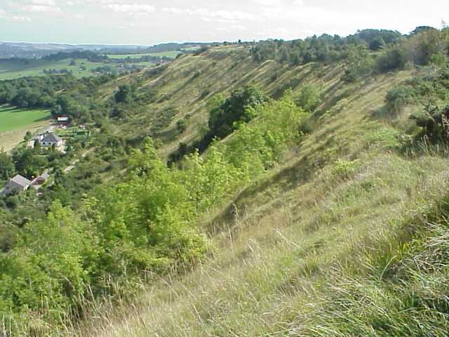
Cotswolds Scarp
Western
edge is
Cotswold
Scarp and
behind is
Thames
catchment

Slide 10
Defining the area

Slide 11
Ground water

Slide 12
Current Ecological Status (WFD)

Slide 14
Approach to collaborative working
Integrated Local Delivery (ILD) framework
Integrate existing related work/interests with WFD
Value local & national expertise
Reconnect communities with farmed and water environment
All partners working together (sharing data, delivery and developing projects)

Slide 15
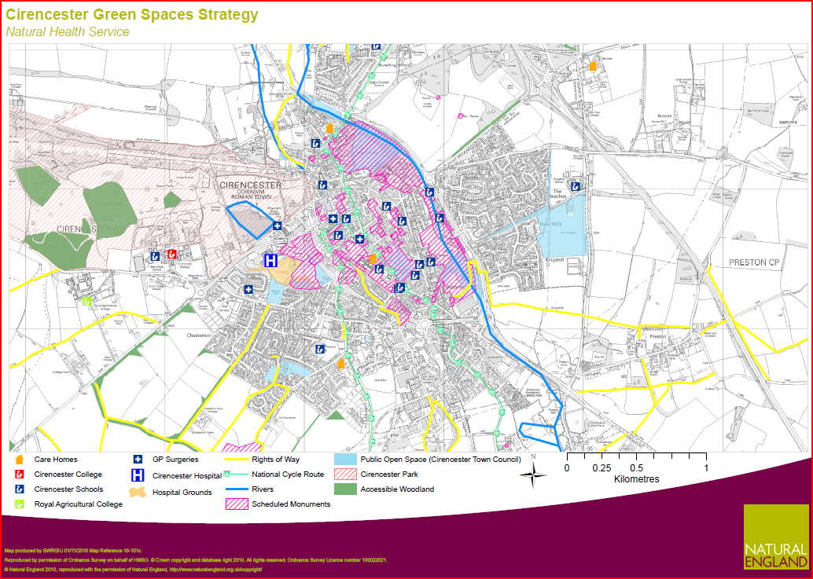
Cirencester – applied to market towns - wards

Slide 16
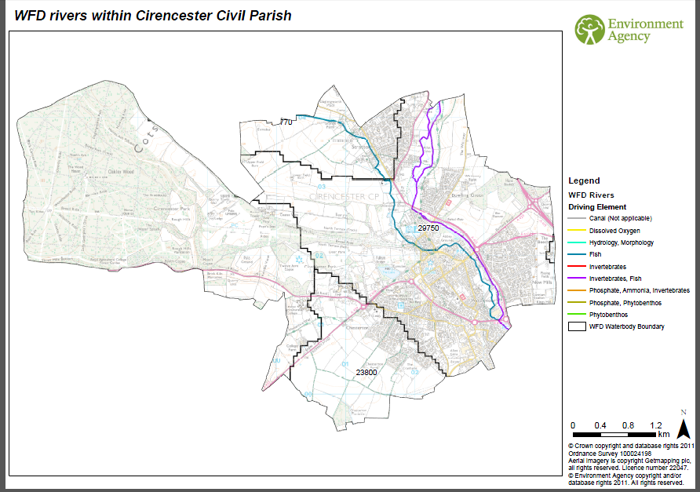

Slide 17
Scoping of partners – needs facilitation to join it up
The SE Environment Agency – Environmental Mngmt & Planning, Biodiversity, Fisheries and Flooding
Natural England – AES, FATI, ETIP, CSF, SSSIs
Forestry Commission – EWGS
Business West – FISS, REG, SWARM, R 4 F, S 4 P
The Rural Payments Agency – underpinning Cross compliance and GAEC
Parish Councils – through GRCC and Parish Plans
District Councils – Resilience planning, development, conservation, waste etc
County Councils – SIDP, SUDS, Highways, Education, Right of Way/ Archaeology/ Ecology
District Councils - Conservation, Waste, Planning
Borough/ Town Councils – Parks, Landscape, Green infrastructure, Great Western Community Forest, Save Water Swindon
NGOs: Cotswold River Trust, Glos WT, CLA, NFU, CPRE, Agronomists, Land Agents, Cotswold AONB, Cotswold Water Park etc Media

Slide 18
Cross boundary working at local authority level

Slide 19
Merging priorities
Multiple initiatives to be overlaid (WFD and CSF)

Slide 20
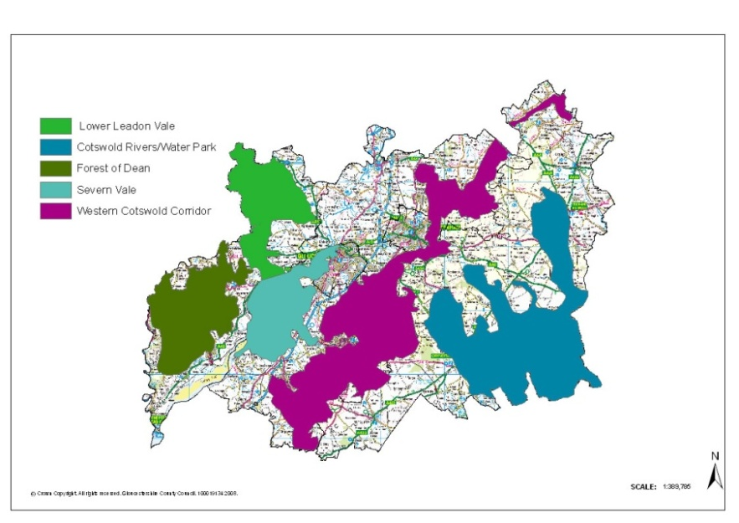
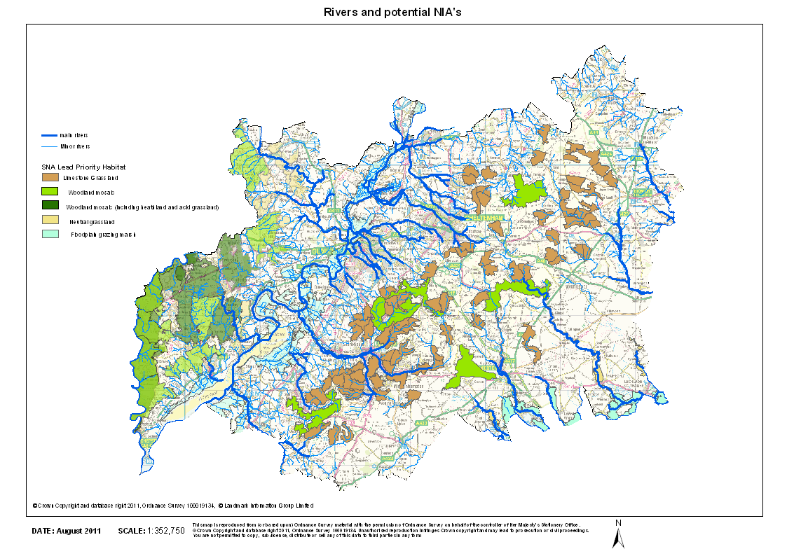
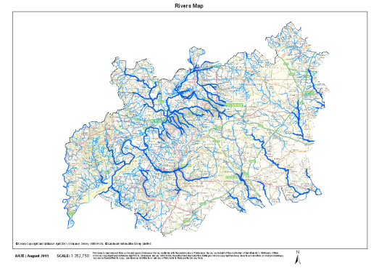
EU Directives to deliver – a integrated spatial strategy
http://ec.europa.eu/environment/pubs/factsheets.htm

Slide 21
What we have learned so far?
There is a clear need for join up
Determining the area has been interesting!
There is overlap, duplication and single issue delivery within the catchment
The multiple voices means mixed messages for farmers, landowners and communities
Role for an Integrated Catchment Plan?
What can be achieved in a year?
Starting point for long-term change.

Slide 22
Testing the benefits of integration
Supports the delivery of strategic objectives?
Partners linked to identified assets and expertise.
Inspiring and enabling local communities?
as a resource for delivery
Assess behaviour change among stakeholders
Views on ‘different way of working’?
Does integration lead to better outcomes?
Early days, time will tell

Slide 23
Chris Short, CCRI
cshort@glos.ac.uk
Jenny Phelps, Gloucestershire FWAG (jenny.phelps@gloucestershirefwag.org.uk)

